Slide 1
Fascism Redux
Clarifying and Contextualizing the Radical Right

Slide 2
Echoes of 20th Century Fascism in Modern Politics and Culture
Is “fascism” the word we’re looking for?

Slide 3
Not Wrong; Imprecise

Slide 4
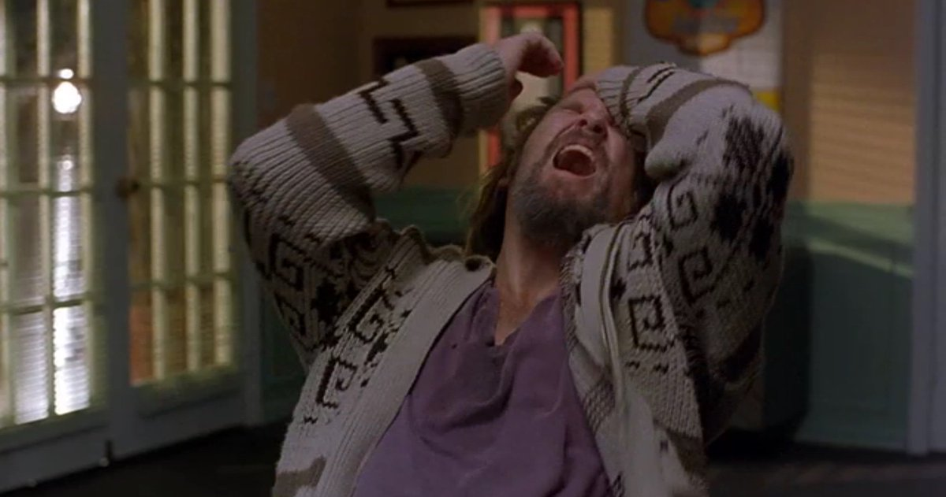

Slide 5
Why are we clarifying?
Precise critiques in defense of democratic values

Slide 6
What is Fascism?

Slide 7
Major Themes in Fascism
Hyper-Nationalism
Militarism and Expansion
Absolute State Power
Rejection of Diversity

Slide 8
Echoes in the Modern Day
Political Parties
Neo-Nazi/ Hate Groups
State Authority

Slide 9
Echoes in the Modern Day
Suppression of Freedom and Diversity
Centralization of Power in the Executive
Militant Nationalism
Grassroots Radicalization

Slide 10
Reducing the term to a pejorative makes it imprecise and rhetorically ineffective

Slide 11
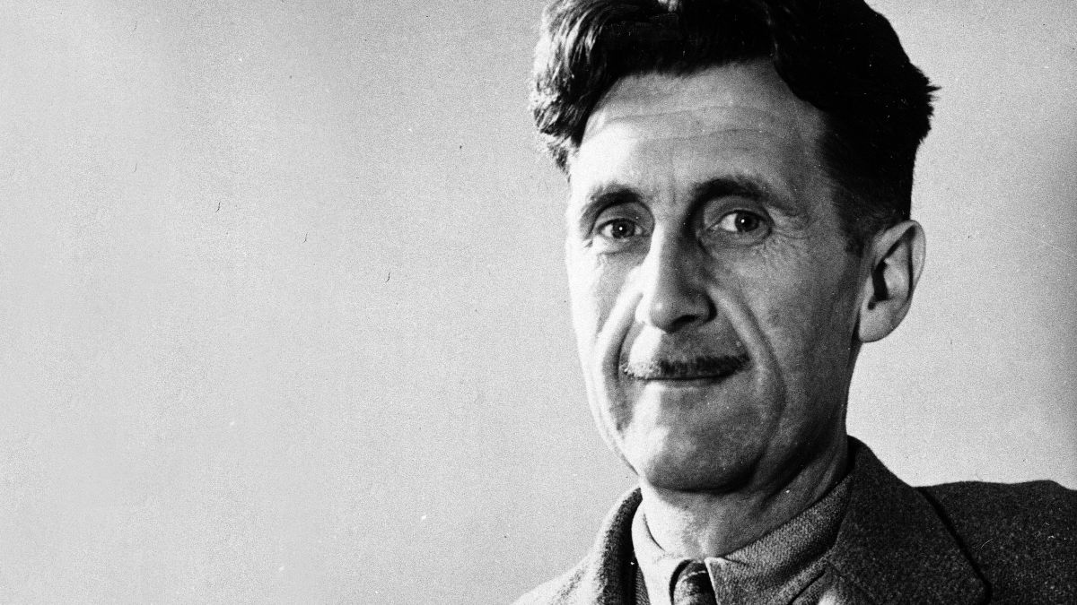
…almost any English person would accept ‘bully’ as a synonym for ‘Fascist’

Slide 12
Call it as it really is…
Racist
Militant
Xenophobic
Authoritarian
Anti-Democratic

