Slide 1

By Walter Lorenz Lecturer in Arabic
Jennifer Lane Ph.D Candidate, Department of Education
Emily Hodge Ph.D Candidate, Department of Education

Slide 2

This session will explore the use and misuse of certain “hot words” of the Arabic language
that are commonly found in the U.S. media. The meaning of their linguistic roots, daily usage and the perspective taken by the U.S. media will be discussed.

Slide 3

Introducing the Arabic Language
Defining “hot words”
Arabic loanwords into English

Slide 4

Arabic ranks sixth in the world's league table of languages, with an estimated 186 million native speakers.
As the language of the Qur'an, the holy book of Islam, it is also widely used throughout the world.
!لاهس و لاها
It belongs to the Semitic group of languages which also includes Hebrew and Amharic, the main language of Ethiopia.

Slide 5

An Arabic word is composed of two parts:
The root: usually formed of three consonants. These consonants remain in the same order.
The pattern: additional consonants and vowels can be added to the root to produce another word according to a certain pattern.
Different patterns created with the same root letters might make abstract concepts from concrete words.
One Arabic word could equal 3-4 English words.

Slide 6
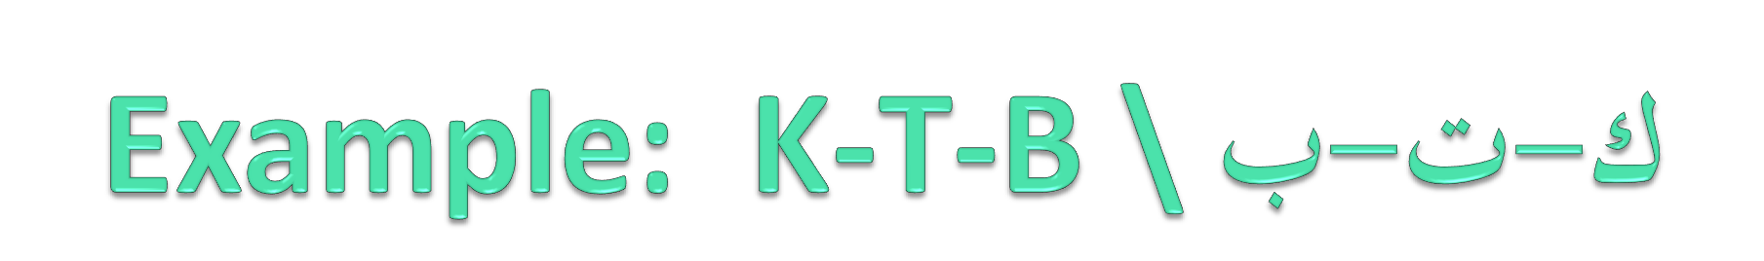
باتك ةتاك ةتكم ةثتكم ةتاتك ةتكأ
Kitaab Kaatib Maktab Maktaba Kitaaba Aktub
Book Writer Office Library Writing I write

Slide 7

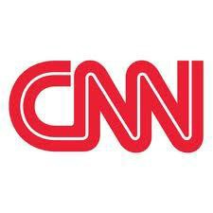



Question?
What are some “Hot words” of the Arabic language that are commonly found in the US media?

Slide 8

Islam Muslim Allah Sharia Jihad Qur’an

Slide 9
Political Cartoons

Slide 10
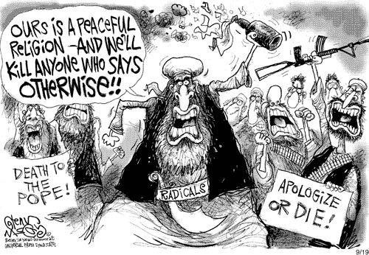

Slide 11
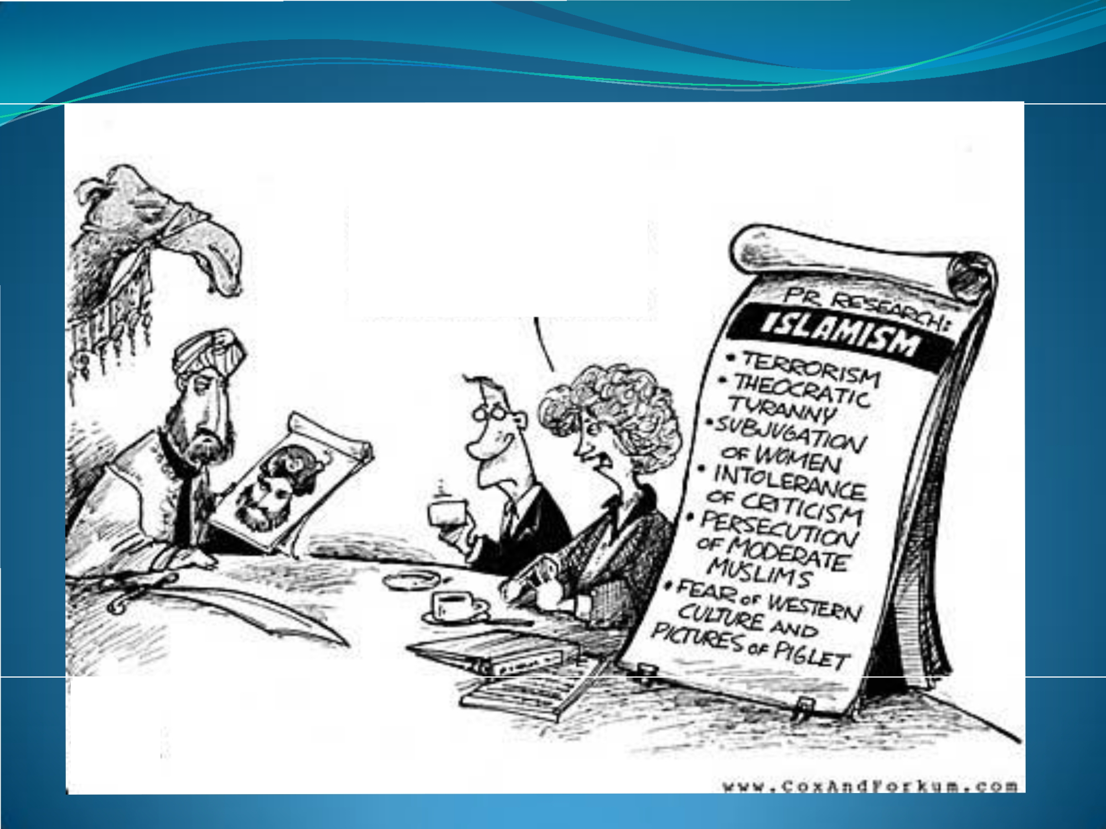
FRANKL\', i\\R.
El)..
A fEW
\SK ('AOONS
-rn L6A>1" OF
lw.,E.
•• #
I'.
•
'1

Slide 12
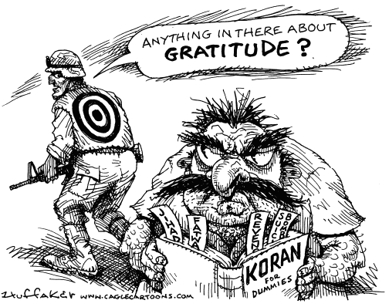

Slide 13
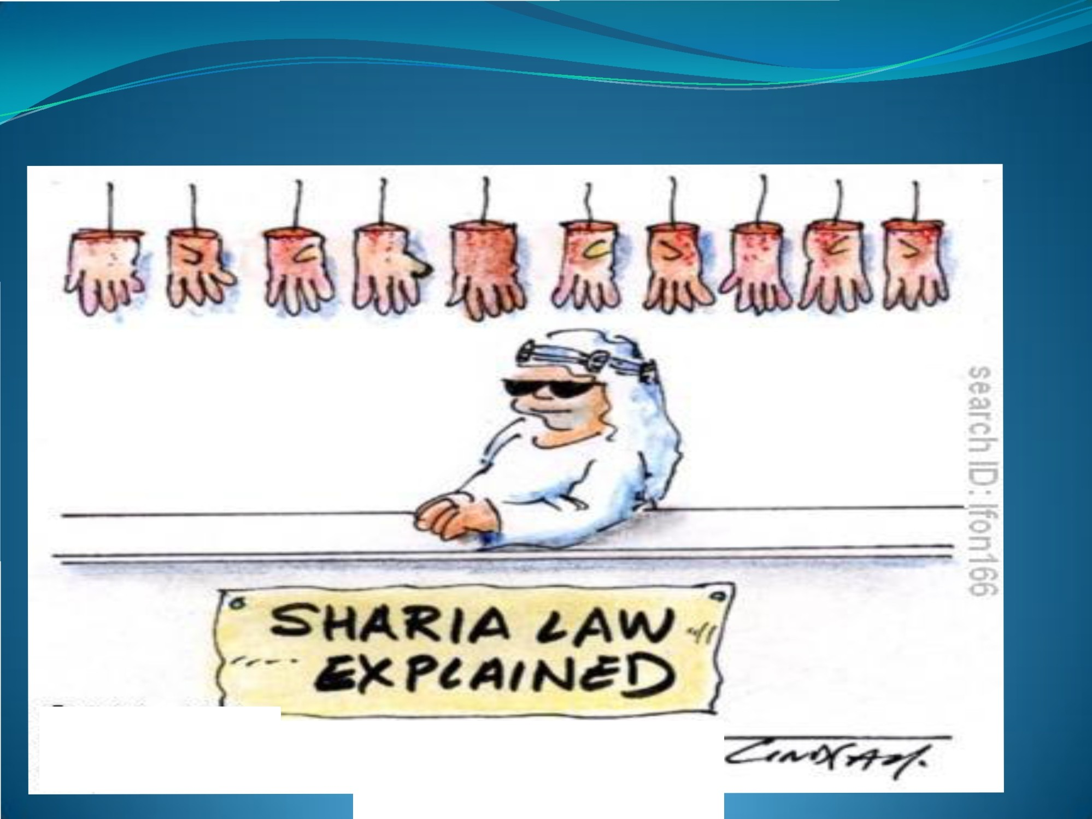
© Origina IArt ist
Re-p·ro-d Lfct ia·n-rights-a·bta in-ab Ie-f ro·m
vvww.Ca rtoonSt ock.c om

Slide 14
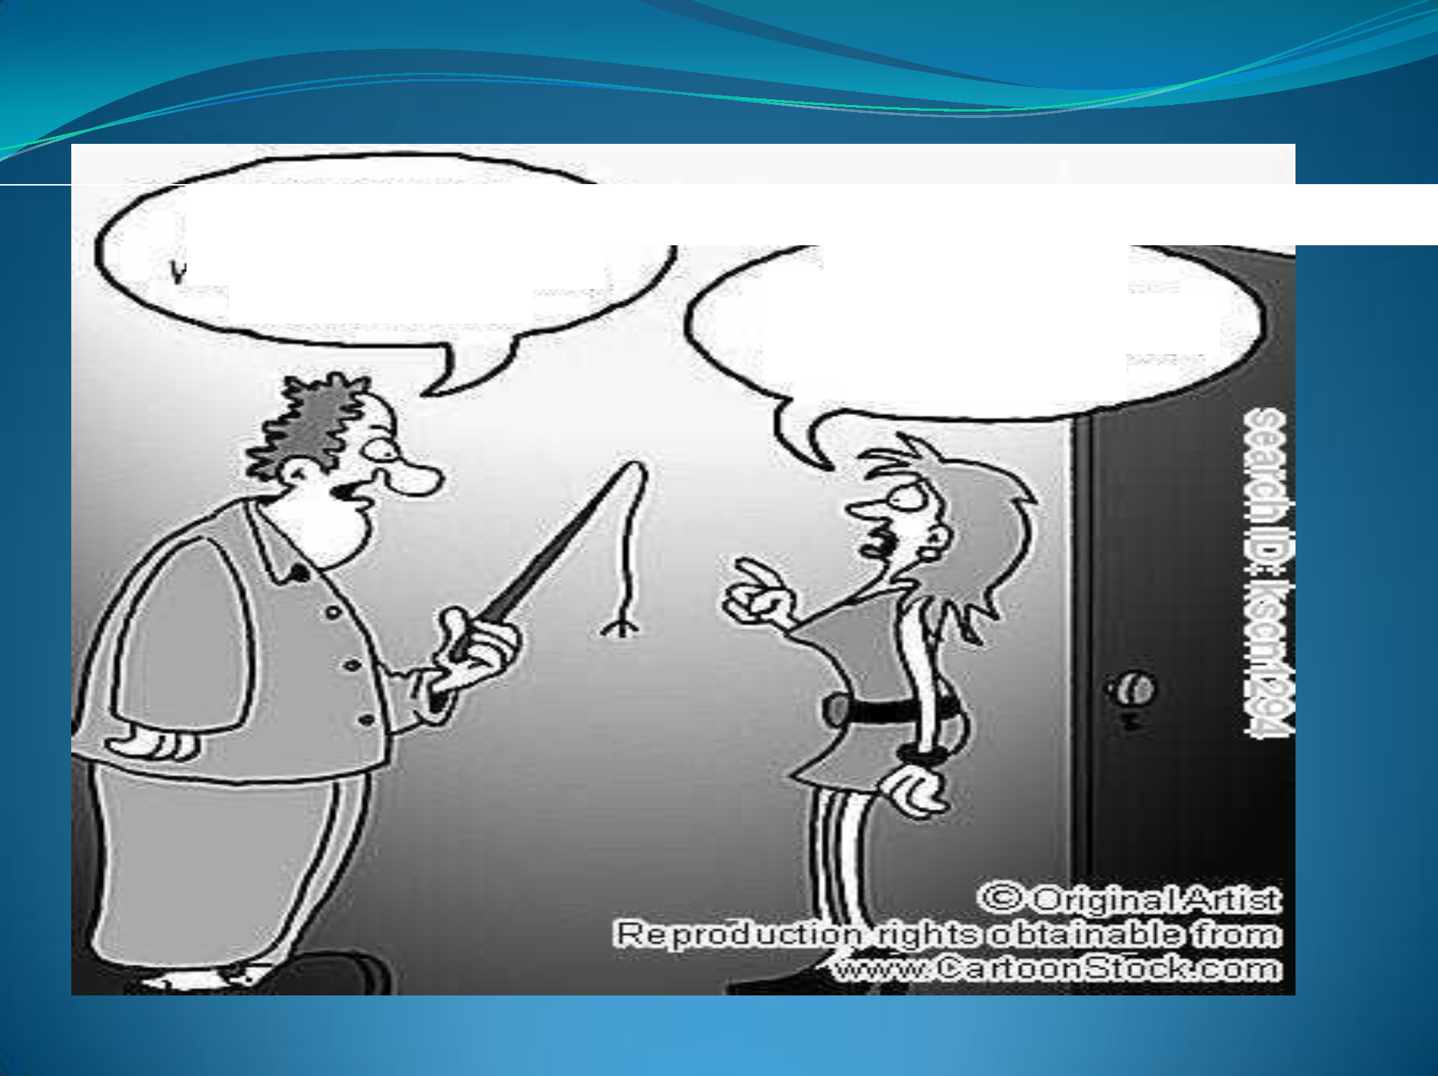
TWO HOURS
LATE:••• You KNOW WHAT THAT M EAN S, YOUNG LADY?!
C'MON1 OAD.--
1 WANT GOOD OLD HOUSE At<RE!ST, NOT
THE SU.ARIA!

Slide 15
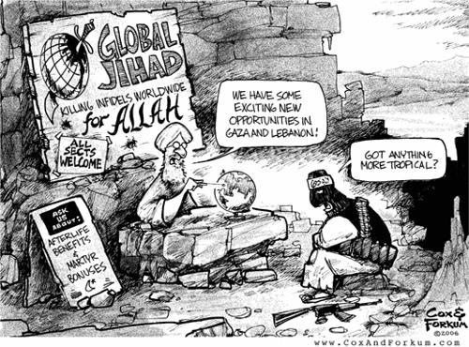

Slide 16

-Monotheistic religion practiced by millions around the world.
- Meaning: Submission, resignation,
reconciliation (to the will of God).
-Can you guess the roots?
-Hint: Three consonants.

Slide 17

-Roots: S – L – M
-Other words that may have these roots:
-Muslim - An adherent of Islam (One who submits)
-Salaam – Peace, Safety, Security
-Saalim – Safe, Secure, Intact
-Tasliim – surrender, delivery of goods

Slide 18

-Roots: A – L - H
-Meaning: God (the One and Only as in
monotheism )
-God in other languages –
-Dios – (Spanish)
-Dieu – (French)
-Deus – (Latin)
-Zot – (Albanian)
-Tanrı (Turkish)
-Khoda (Persian)

Slide 19
- Roots: A – L - H
-Other words with these roots
-Ilah – a god, deity (lacking definite article)
-AAlih – a pagan god (lacking definite article)
-AAliha – a pagan goddess (lacking definite article)
-AAlihii – divine, heavenly
-Muta’allih – divine, heavenly
-Al-Ilaahiyaat – theological

Slide 20

-Roots: Sh – R – A’
-Basically known as is the code of conduct or
religious law of Islam.
Other common meanings:
-law, canon, code, pretext, legislation, constitution.
-In archaic Arabic, the term Sharia means “path to the water hole.”

Slide 21

-Many people, including Muslims, misunderstand Sharia.
-Often associated with the amputation of limbs, death by stoning, lashes and other medieval punishments.
-Sharia is applied by Islamic judges and laws are interpreted according to the Qur’an, saying and practices of the Prophet Muhammad, consensus of religious scholars, and deductive analogy.
-Sharia deals with many topics addressed by state law.
-Some nations have a blend of Sharia law and state law. They apply Sharia law towards marriage, divorce, inheritance and family issues.

Slide 22

Ritual worship Transactions and contracts Morals and manners Beliefs
Punishments Purification Prayer Funeral Prayer Poor Tax Fasting Pilgrimage Trade Inheritance Marriage Divorce Justice

Slide 23
-Roots: Sh – R – A’
-Other words with these roots
-Tashriia’ – legal regulations, legislative power
-al-Ishtiraa’ – Deuteronomy, fifth Book of Moses
-Mashruua’ – legal, legitimate, permissible
-Mutasharri’ – legislator, lawgiver, jurist

Slide 24

- J – H – D
-Multiple meanings are found.
-Both violent and non-violent meanings exist.
-Term can mean either a “Lesser Jihad” or “Greater Jihad.”
-Media primarily translates it as a holy war or battle (Lesser Jihad).
-Other meanings:
-Striving to live a moral and virtuous life (Greater Jihad).
-Other uses in Arabic:
-Gandhi's struggle for Indian independence is called a “jihad” and so is the terminology applied to the fight for Women's Liberation Movement.

Slide 25
-Roots: J – H – D
-Other words with these roots
-Juhd – strain, endeavor, effort.
-Ijtihad – exertion, arriving at independent judgment in a legal question.
-Majhuud – endeavor, effort, exertion.
-Mujaahid – fighter, warrior.
-Mujhid – strenuous, trying, grueling.
-Mujtahid – diligent, industrious, striving to achieve a goal.

Slide 26

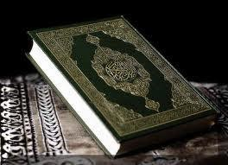
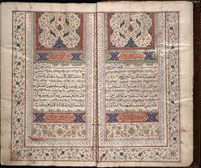
-Roots: Q – R – ء
-Meaning: Recitation
-Revealed from Allah to Muhammad over a period of approximately twenty-three years.
-It was memorized, recited and written down by Muhammad's companions.
Other words with same root: Qiraa’a – reading
Qaari’ – reader, reciter
Maqruu’- legible, readable
Istiqraa’ – investigation, examination

Slide 27

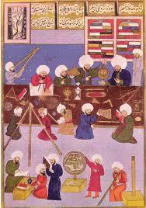
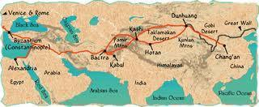
-admiral - amīr al-bihār
-alcohol - al-kohl
-algebra - al-jabr
-assassin - ḥashāshīn,
-coffee, café - qahwa
-cotton - qutun
-ghoul - ghūl
-guitar - qītāra
-magazine - makhāzin
-safari - safar
-zero - sifr

Slide 28

-Certain Arabic words are transformed into “hot words” by
the U.S. media.
-These words possess a variety of meanings, but are overshadowed by stereotypes created by the media and film industry.
-Is this popular portrayal in the media accurate? Is it fair?
-Since the media propagates the popular portrayal of these words, how can we redefine them?

Slide 29



