Slide 1
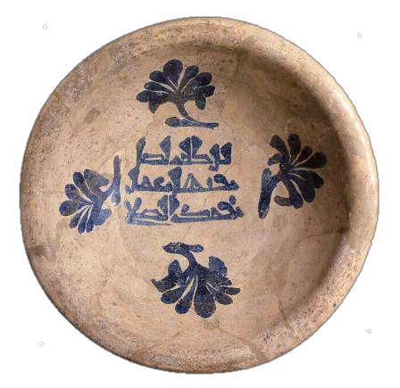
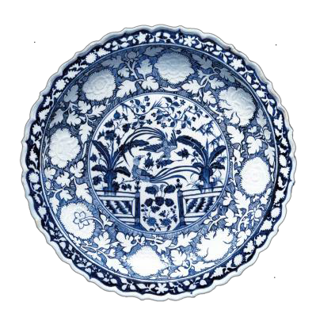
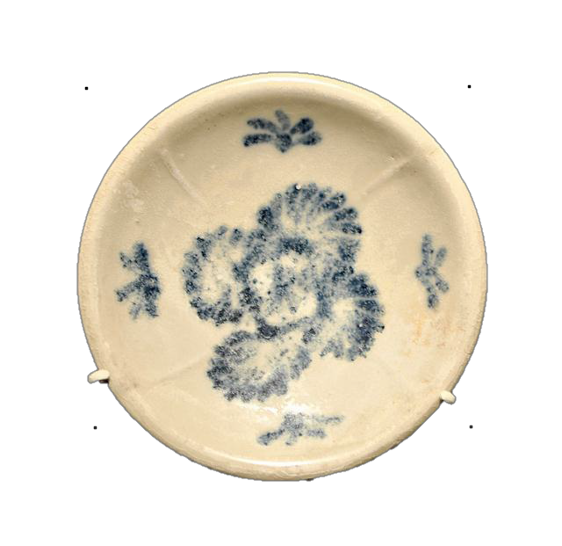
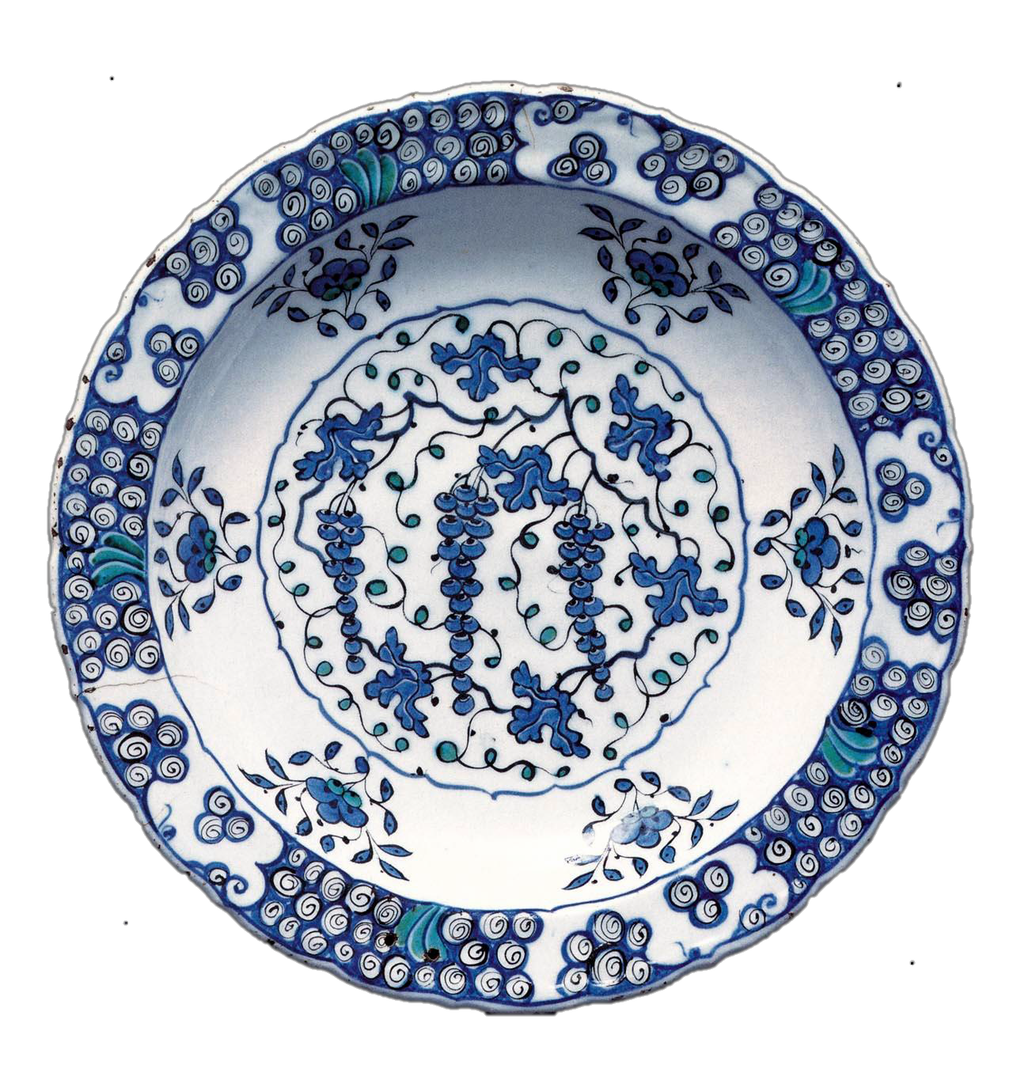
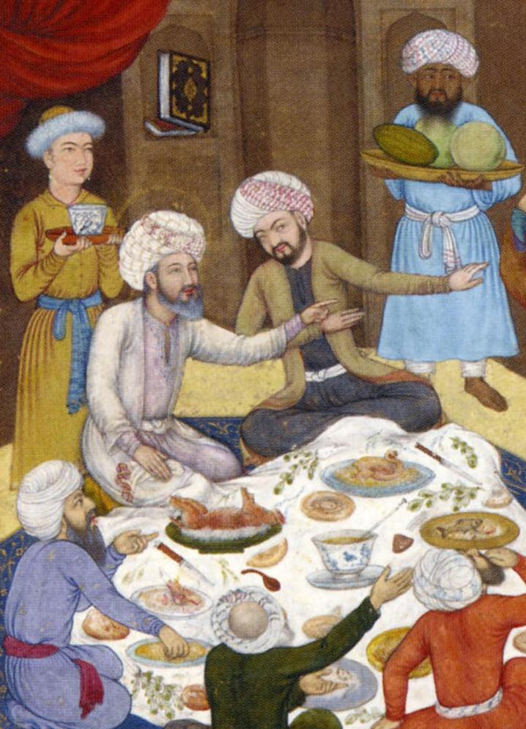
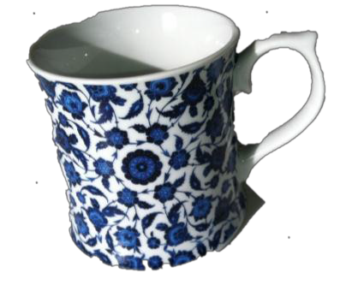
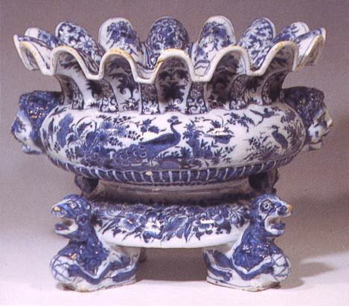
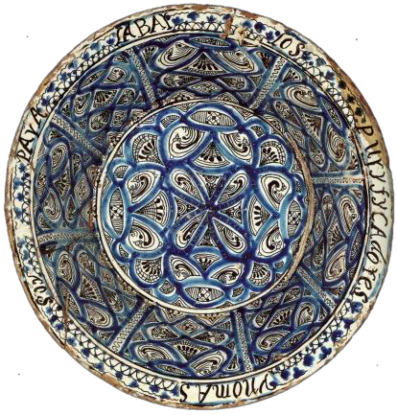
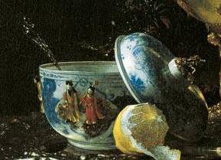
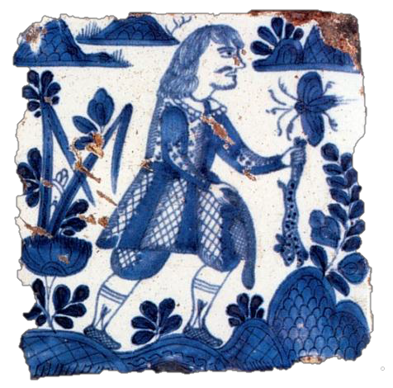
Blue And White Porcelain:
An International Sensation

Slide 2
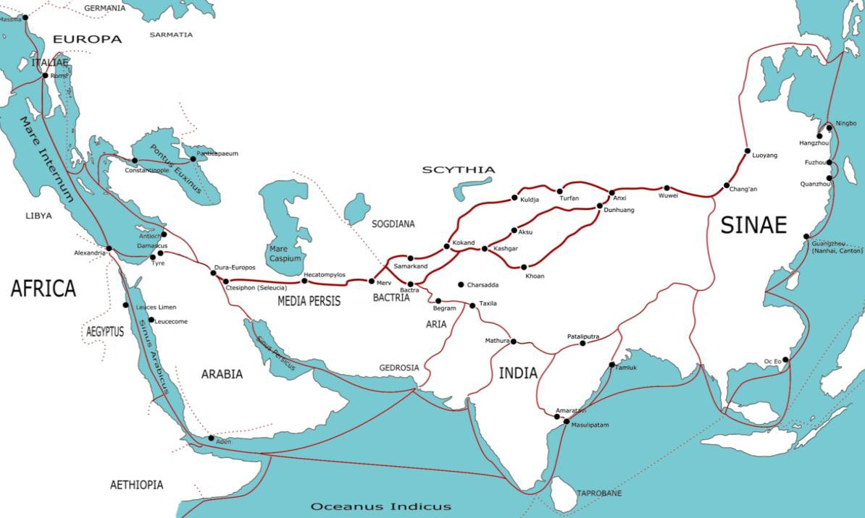
Trade Routes c. 1st c. A.D.

Slide 3
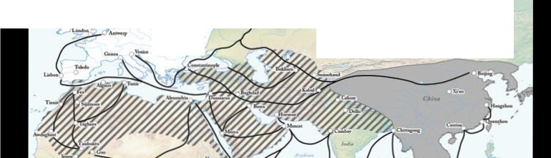
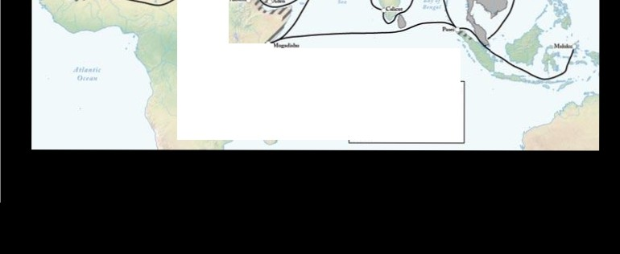
M ajor Trade Ro11tes of lljrotllrasi a r1300 CE
'"' '
Qr.
,, , .
2-.
)
rJ l\1:ajCtr Tnde Roufitt
Im Buddhist \Vorld
Christian \Vorld
/'"h hl•mic World

Slide 4
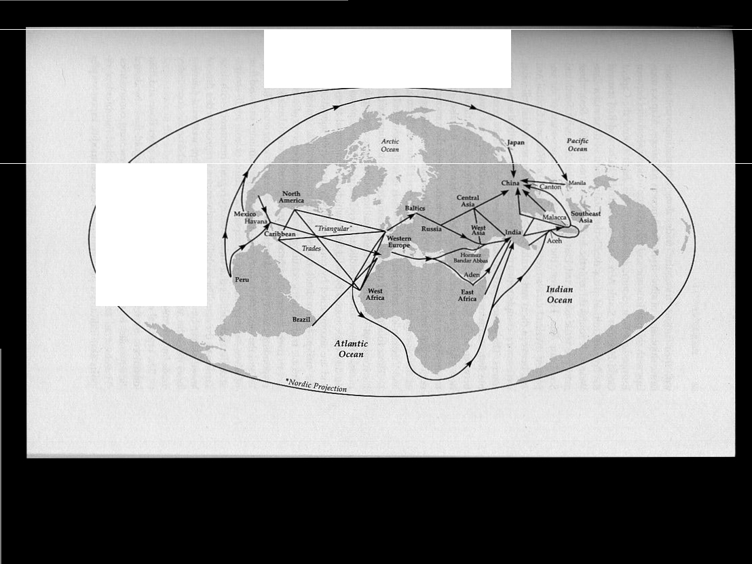
Map 2.1
Major Circum-Global Trade Routes,1400 -1800
Pacific Ocean
Major trNc routes ­
Direction olllow ohil""r -
to pay for tTad I ln
OPJ>O$llt dJn:ction

Slide 5
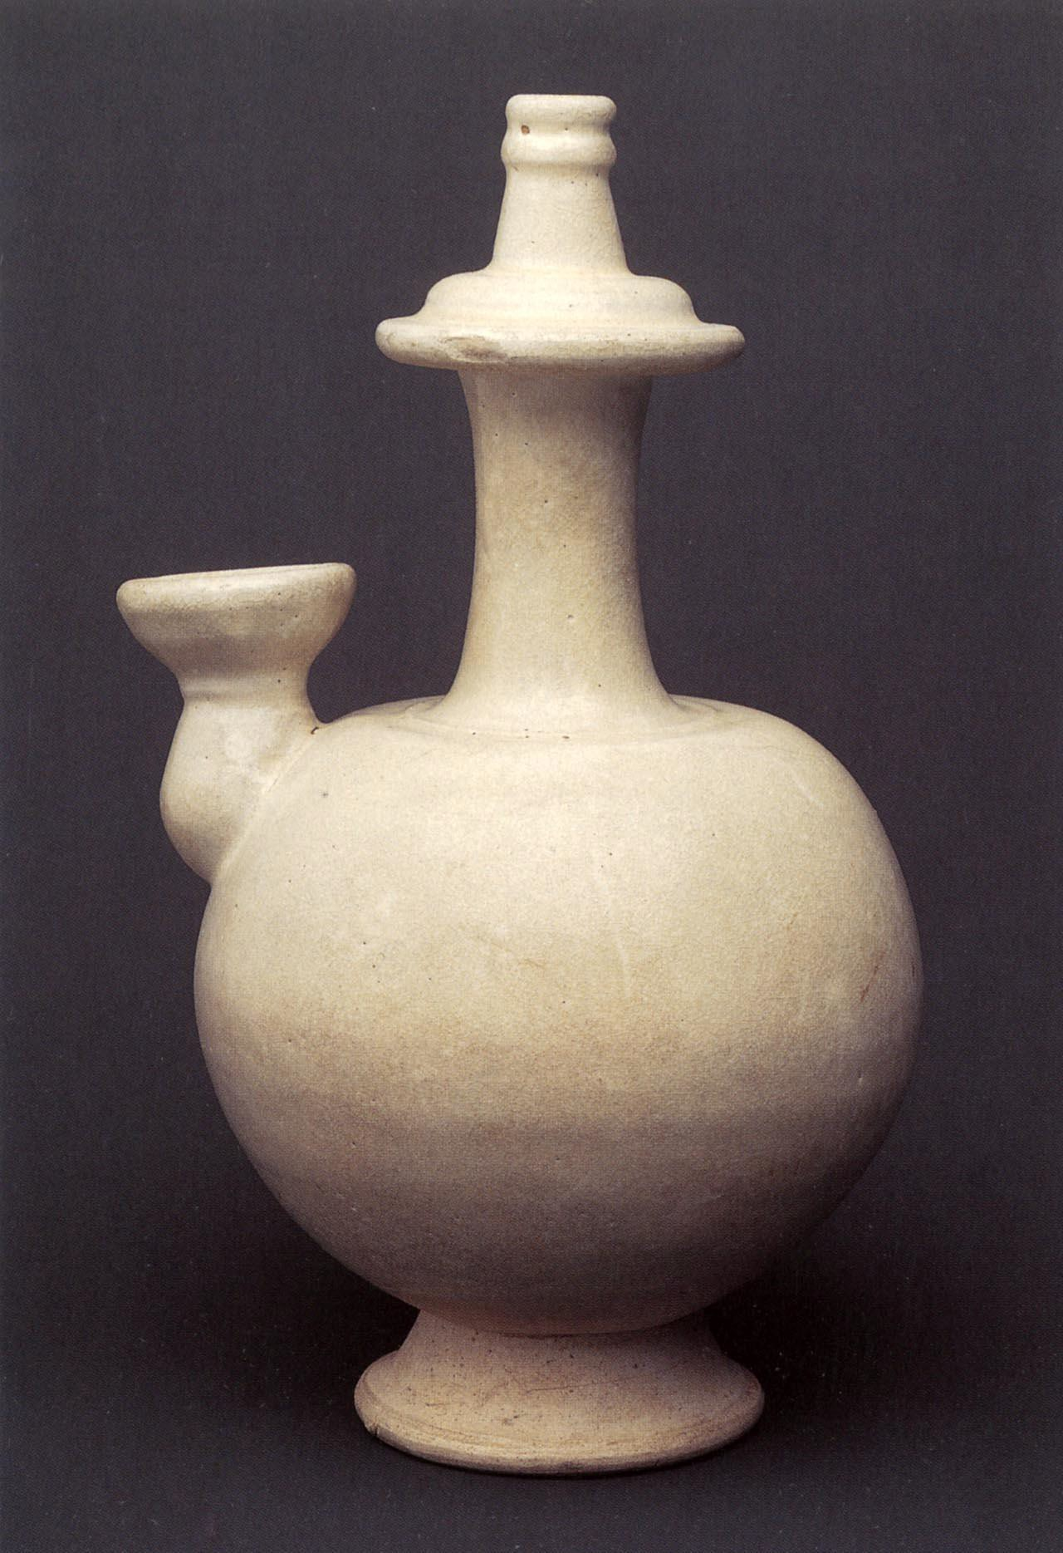
Kendi (drinking vessel), porcelain, China, 7th c.

Slide 6
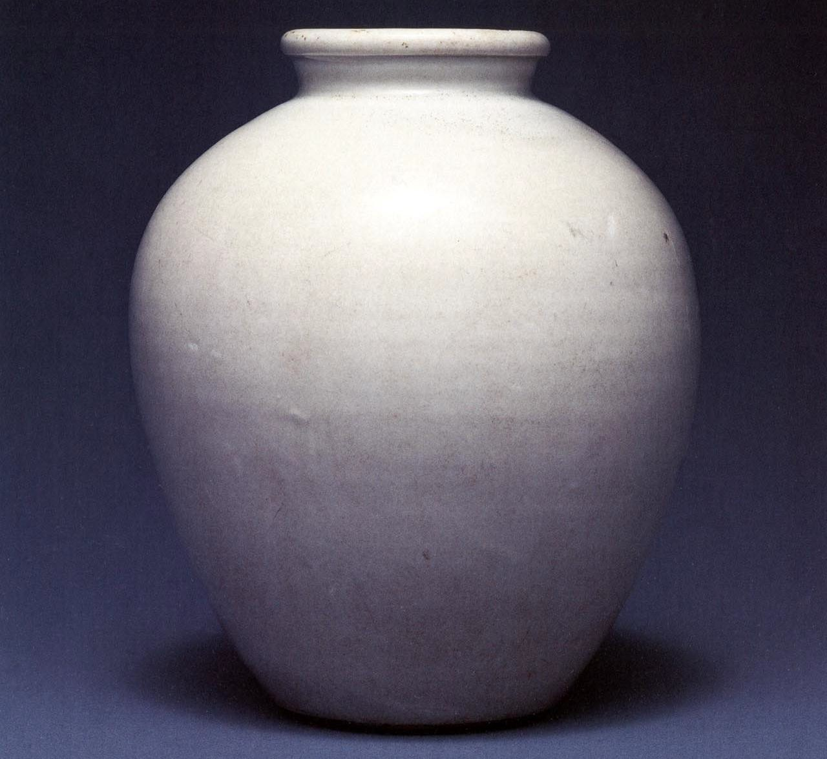
Xing ware jar, porcelain with white glaze, 9th c.

Slide 7
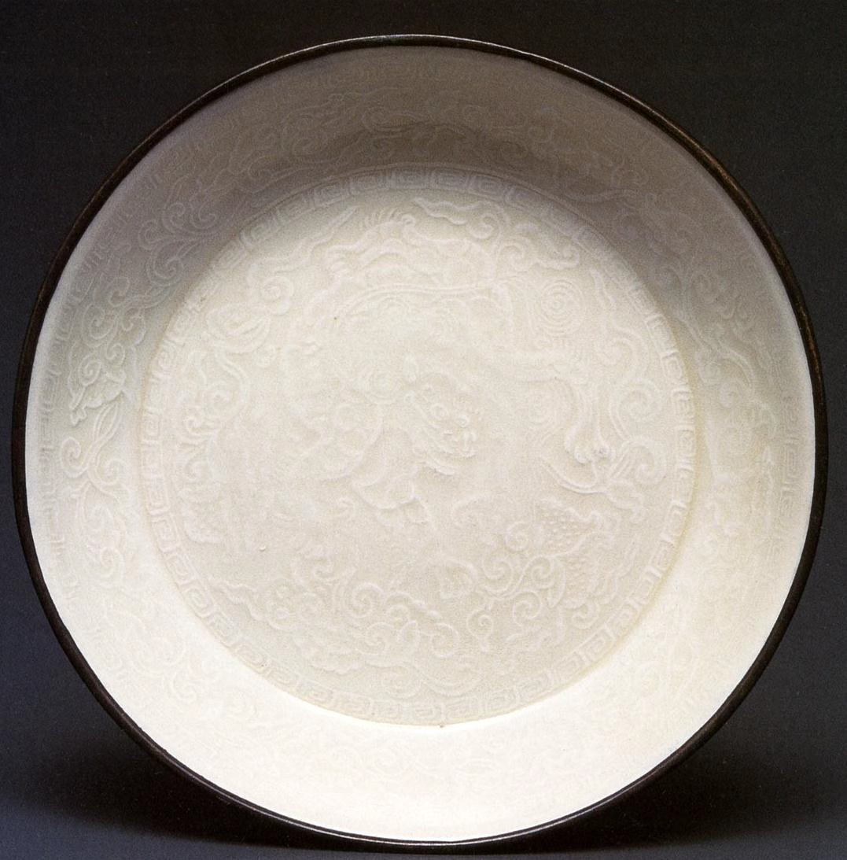
Ding ware dish, molded decoration, 12th c

Slide 8
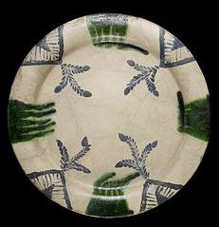
Plate, Iraq, 850-950 A.D.

Slide 9

Plate, Mesopotamia, 9th c.

Slide 10
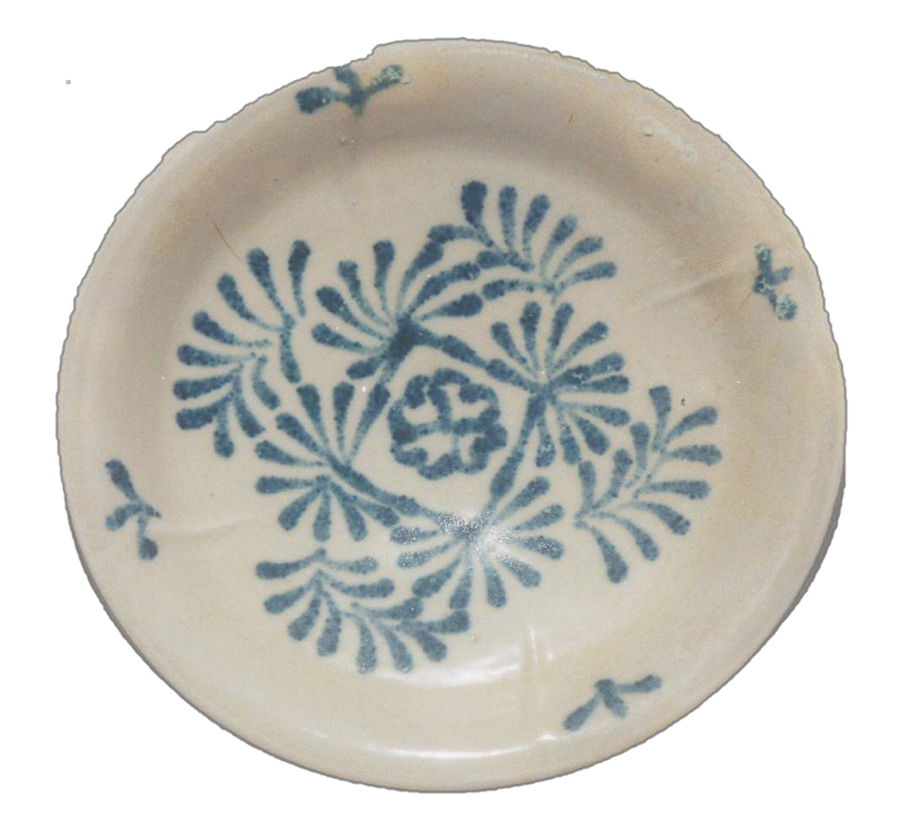
Tang Dynasty, Hebei Province, China
₉th
C.

Slide 11
Tang Dynasty, Hebei Province, China
₉th
C.

Slide 12
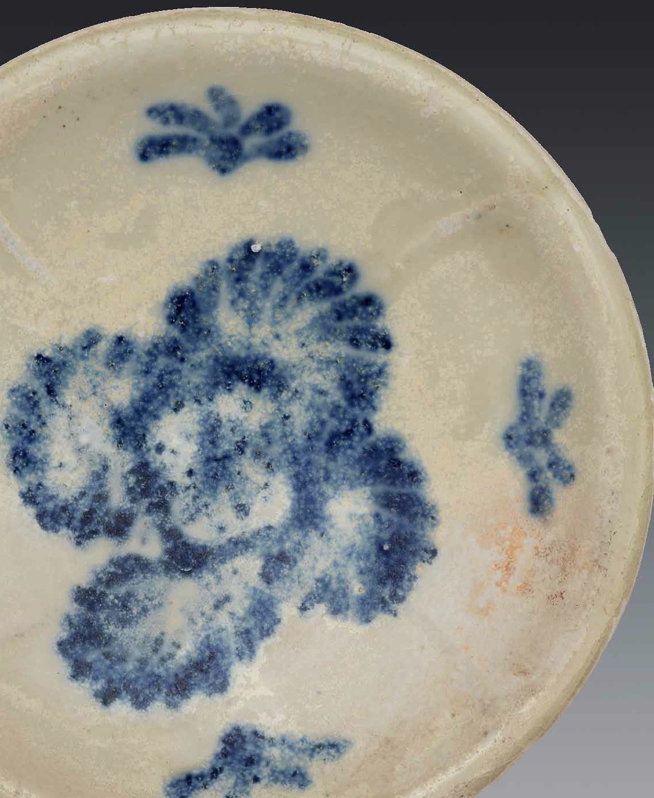

Slide 13
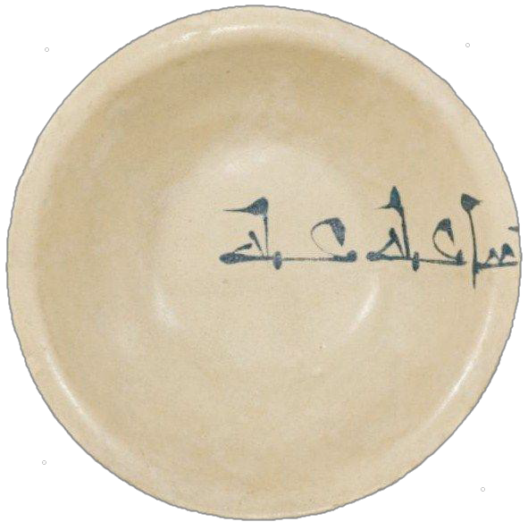
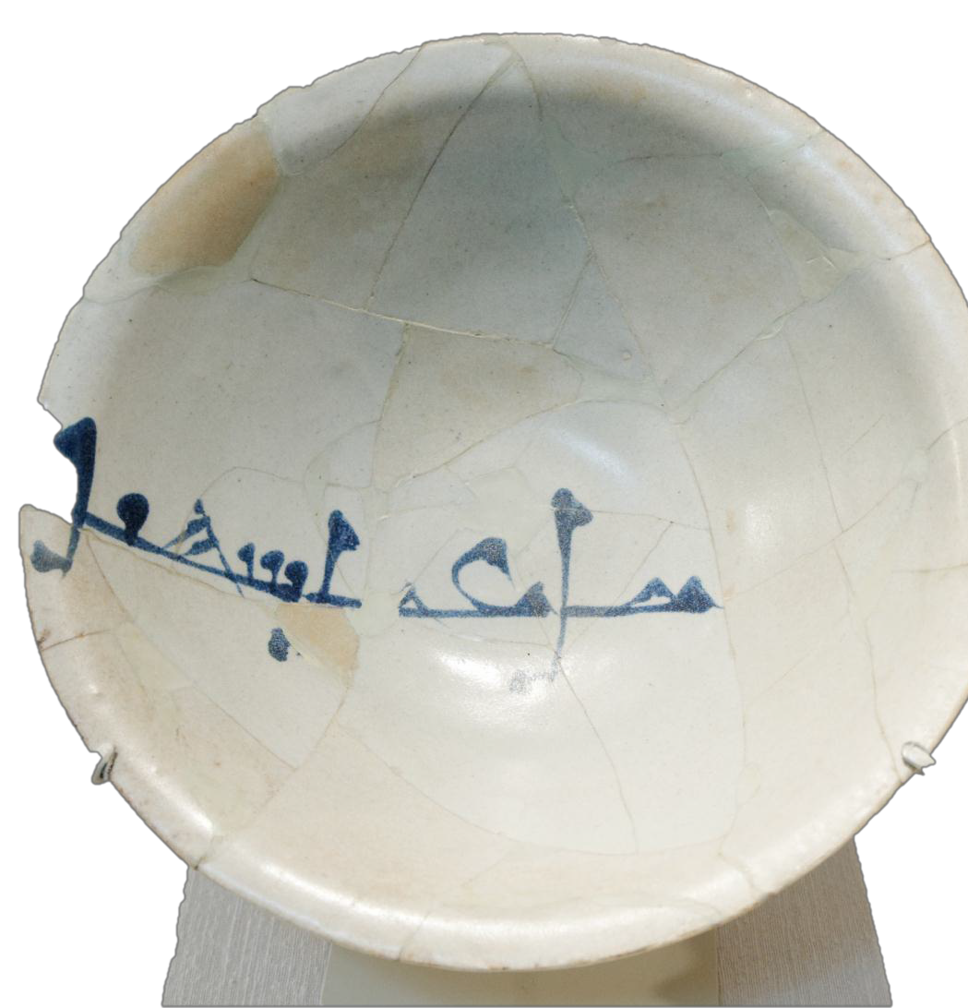
Cobalt-painted bowls, Iraq, 9th-10th c.

Slide 14
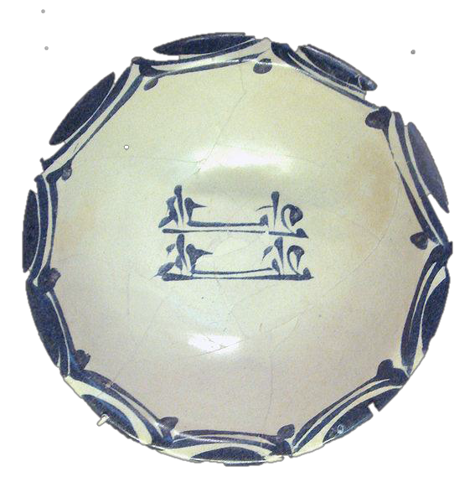
Iraq, 9th c.

Slide 15
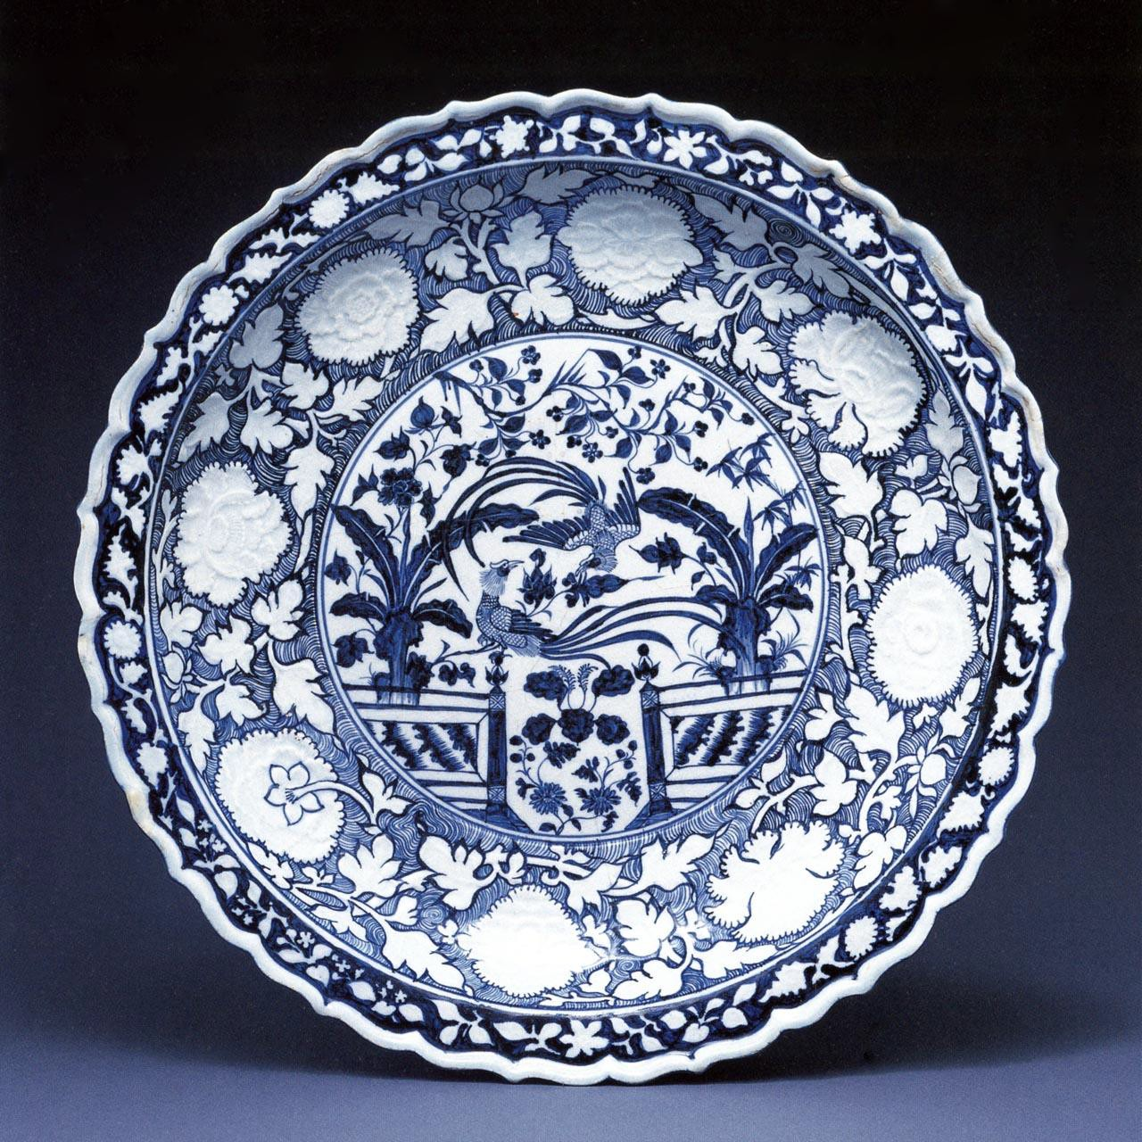
Jingdezhen ware dish, cobalt blue underglaze, 18”, 14th c.

Slide 16
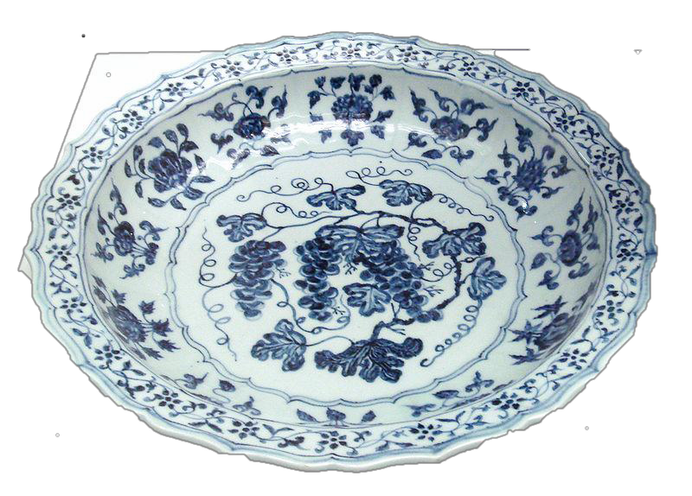
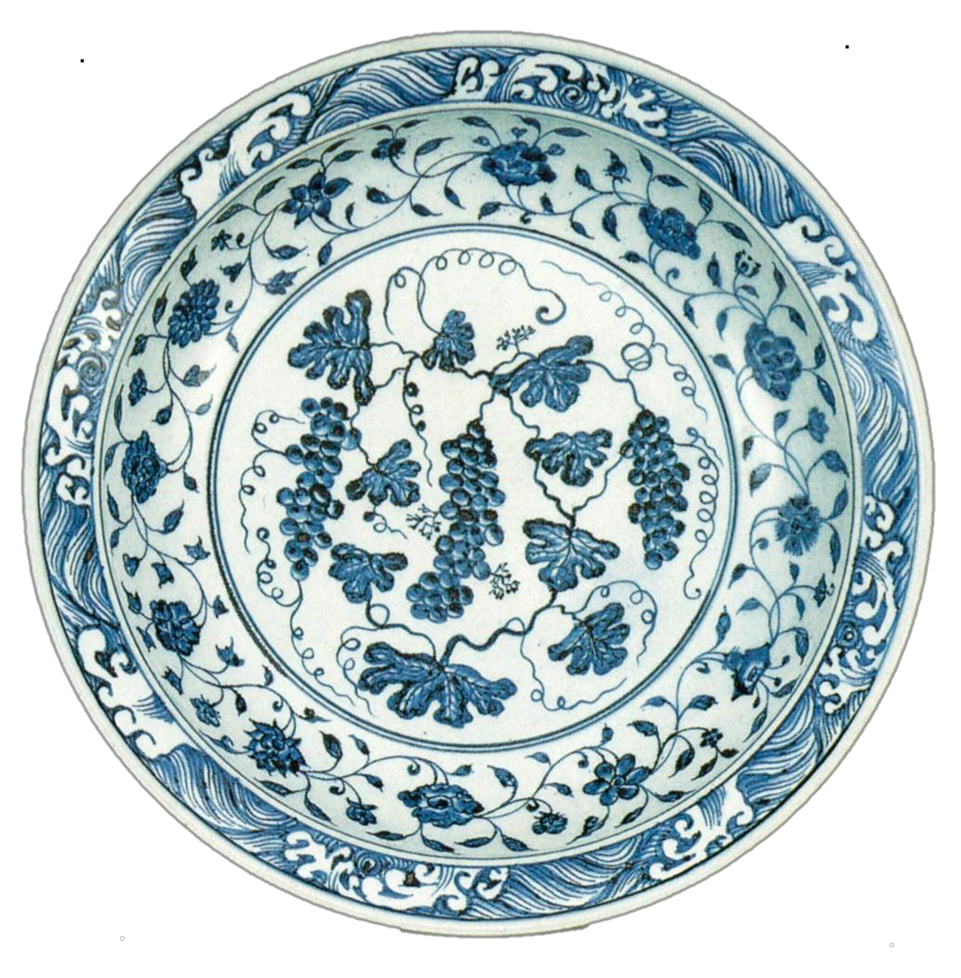
Chinese Jingdezhen plates, c. 1430

Slide 17
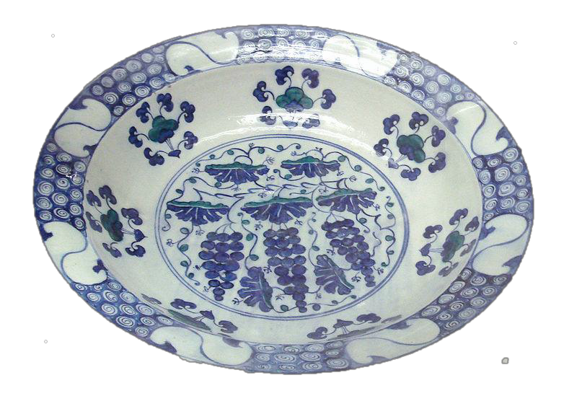
Probably Syrian (Damascus), Ottoman period, late 16th c.

Slide 19
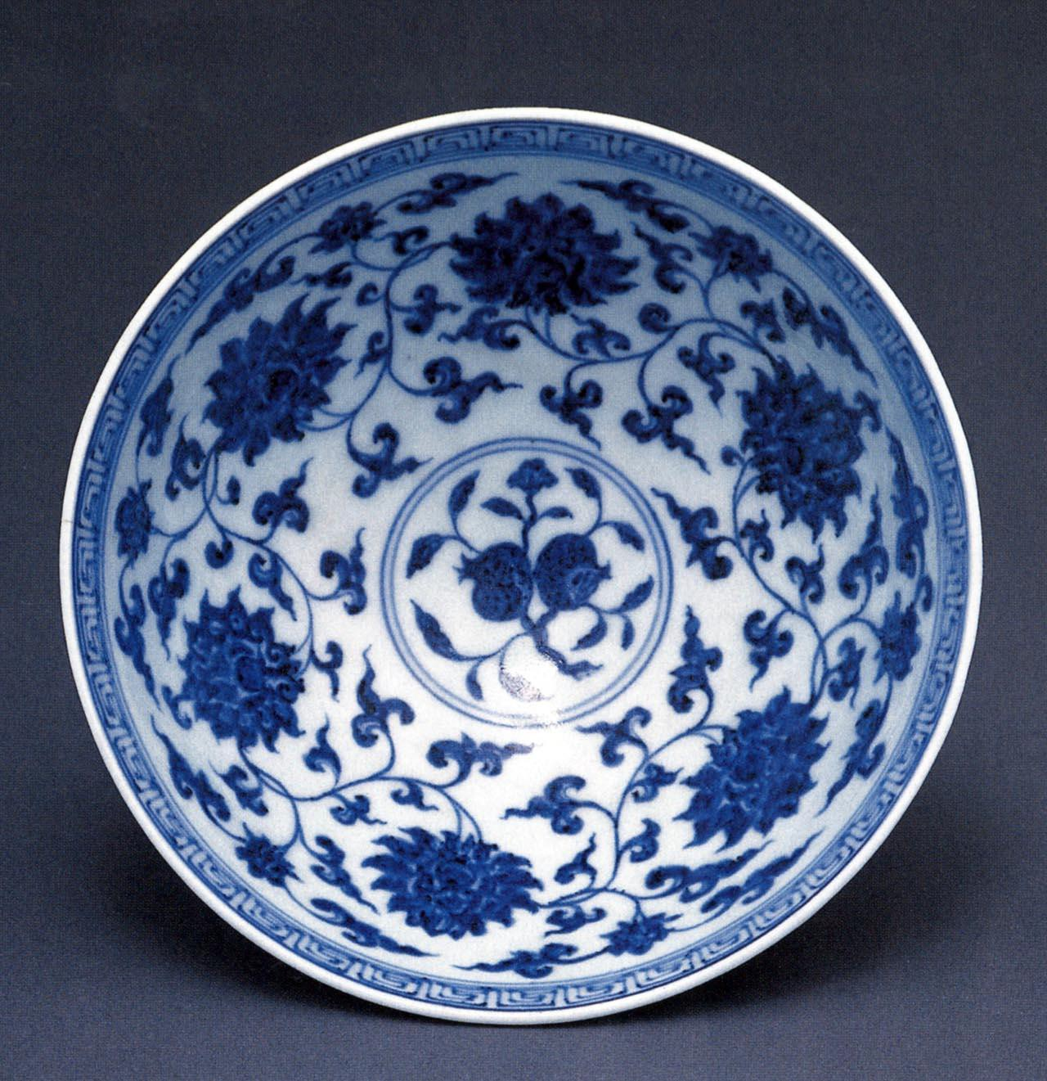
Jingdezhen ware bowl, cobalt blue underglaze, 8½”, c. 1430

Slide 20
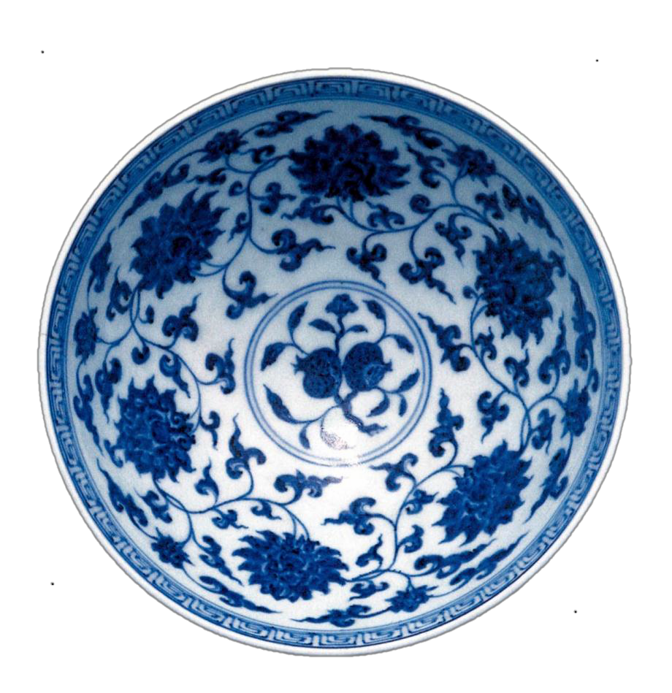
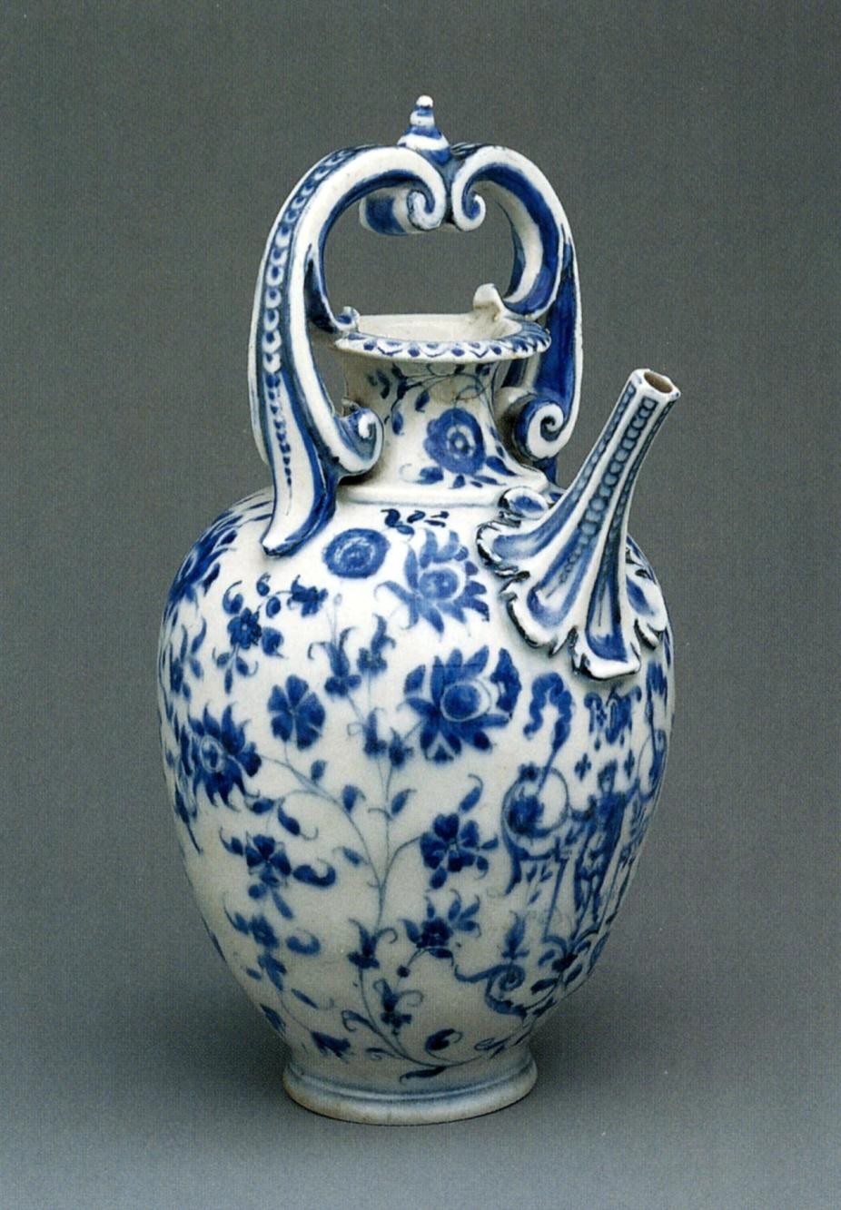
Medici factory ewer, Italy, 8”, c.
1575-87

Slide 21
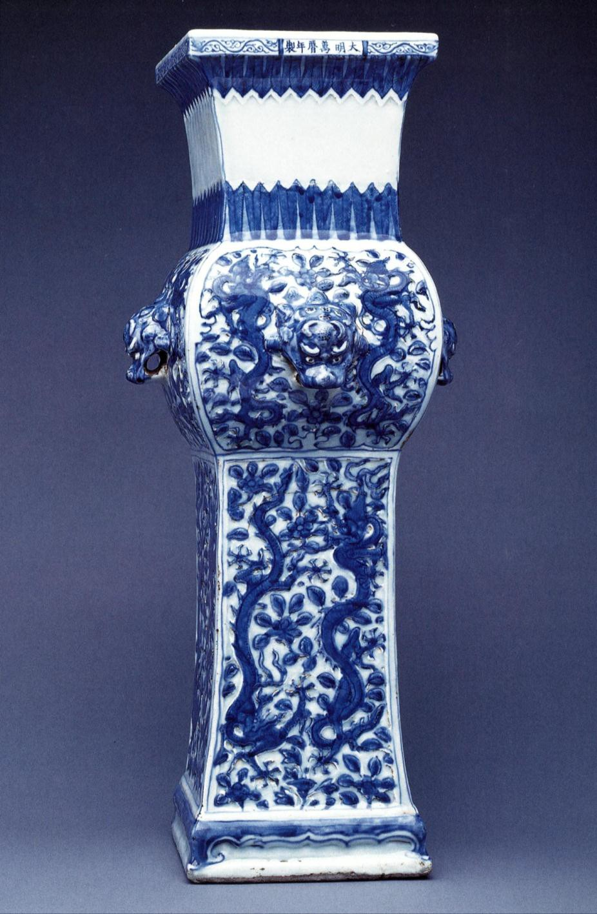
Vase, Wanli reign mark, 1573-1619, 22”, 1573-1619

Slide 22
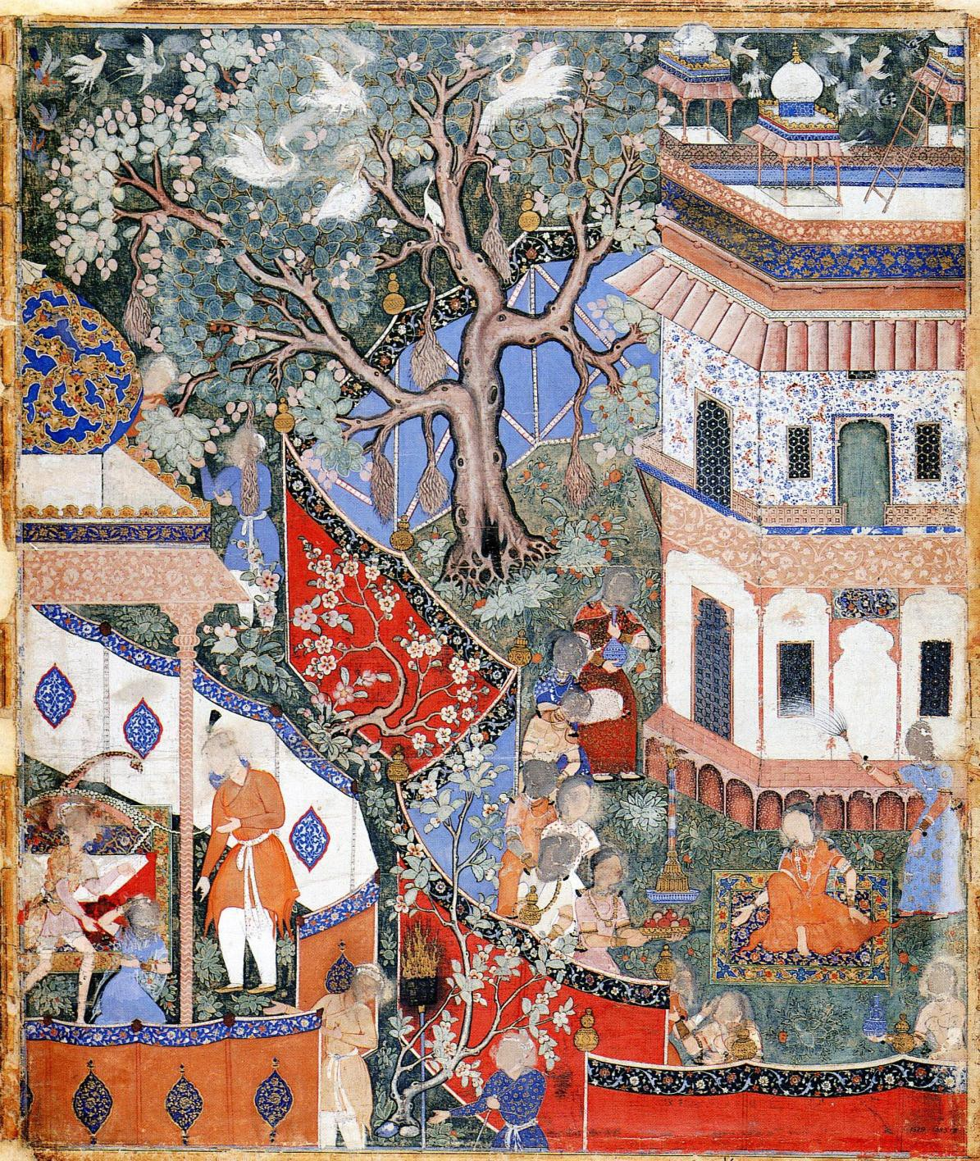
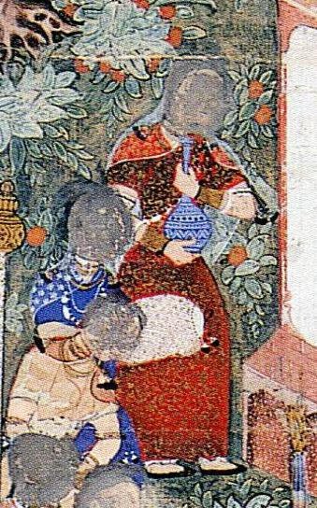
Hamza’s Son, Rostam, Questions a Slave Girl from the Hamzanama, c.
1562-77

Slide 23
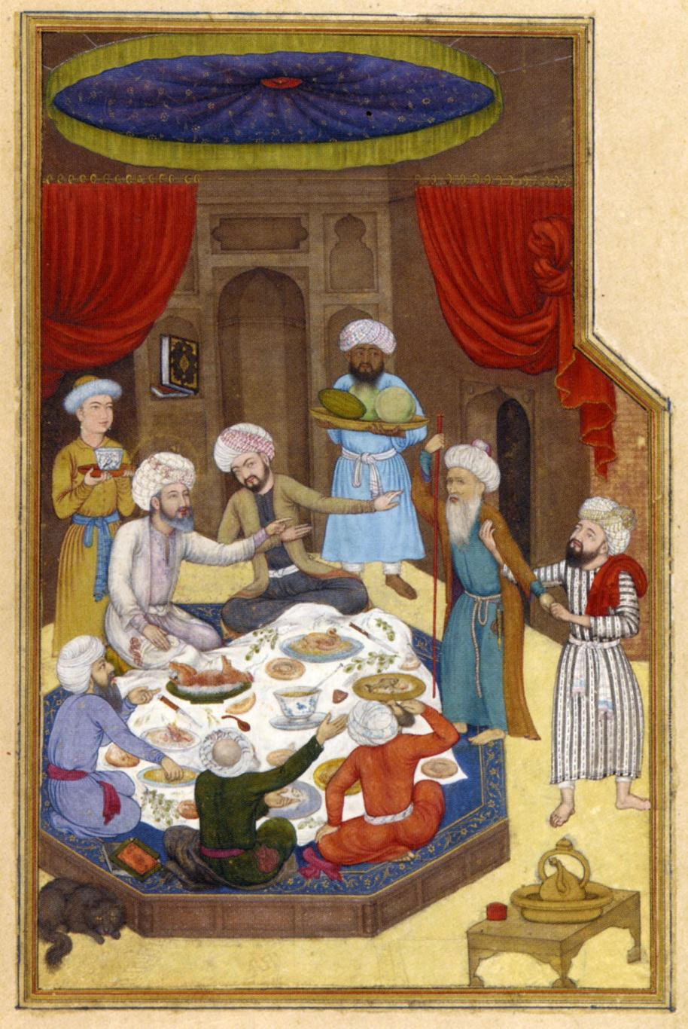
Abu’l Hasan, Ibraham Recieves a Zoroastrian, from a Bustan by Saadi, c. 1605-6

Slide 24
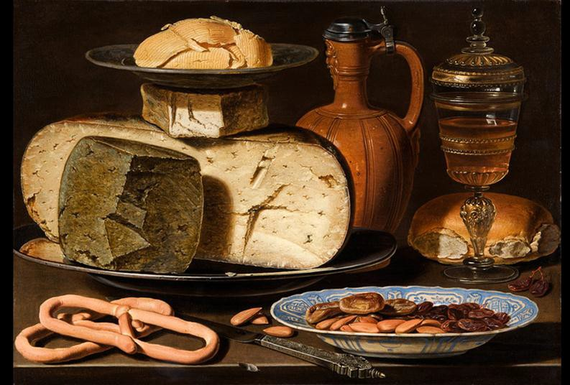

Clara Peeters, Still Life with Cheeses, Pretzels, Nuts and Dates, c. 1610

Slide 25
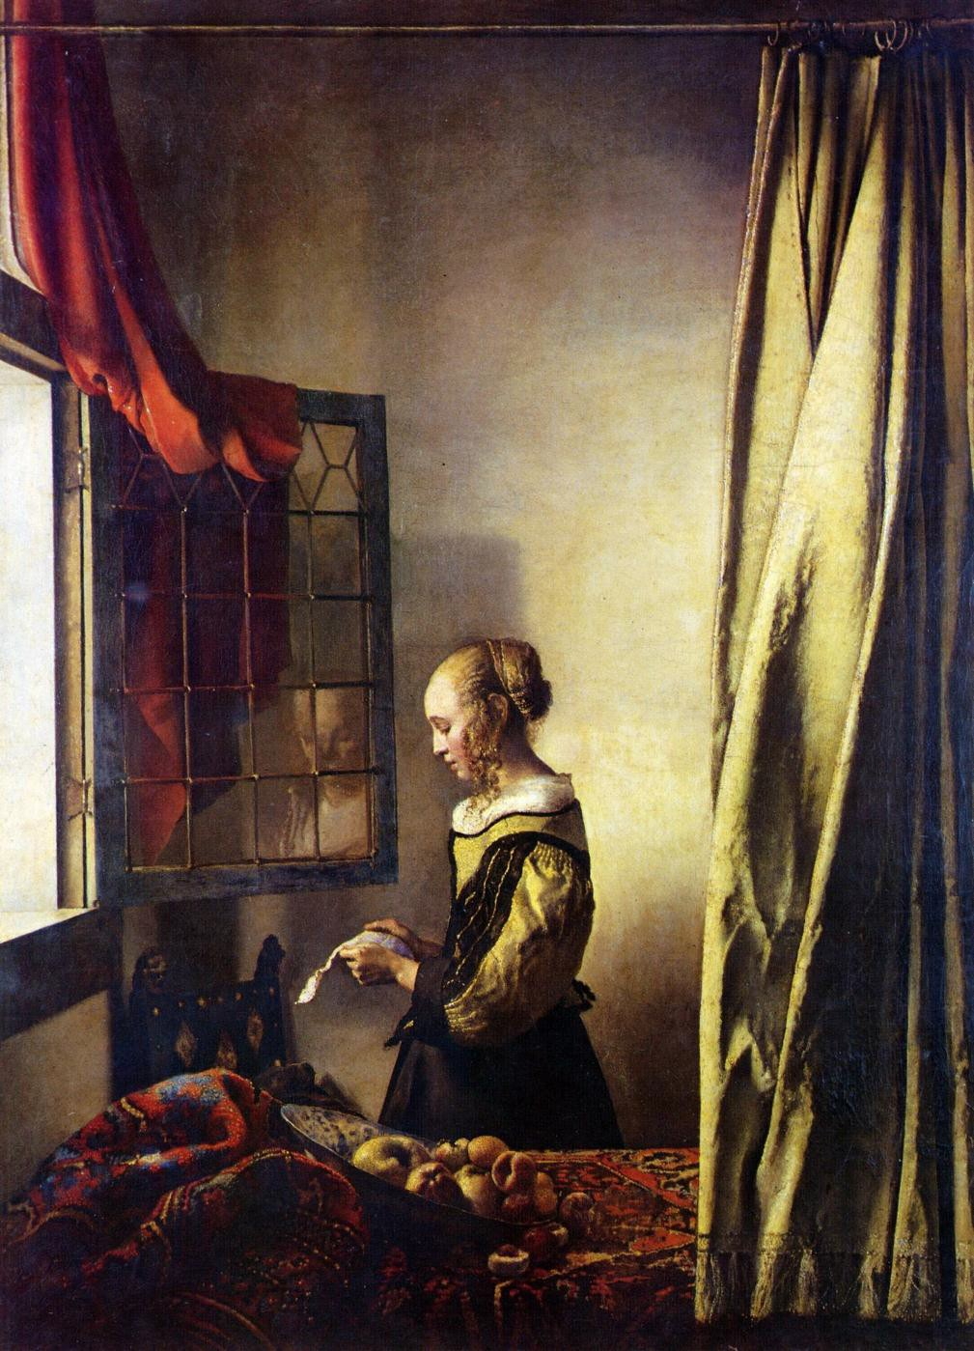
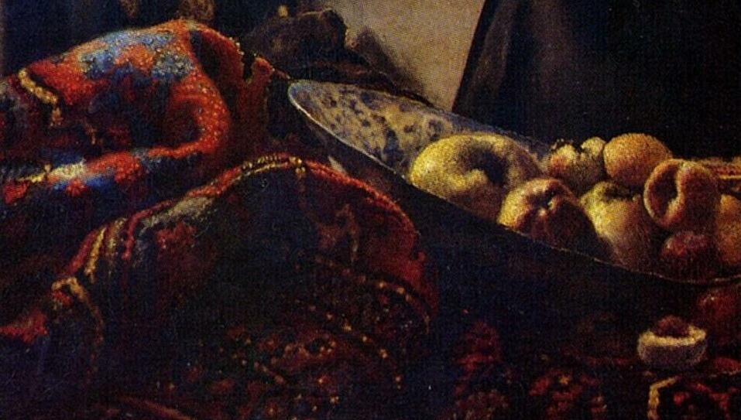
Johannes Vermeer, Woman at Window Reading a Letter,
1657-9

Slide 26
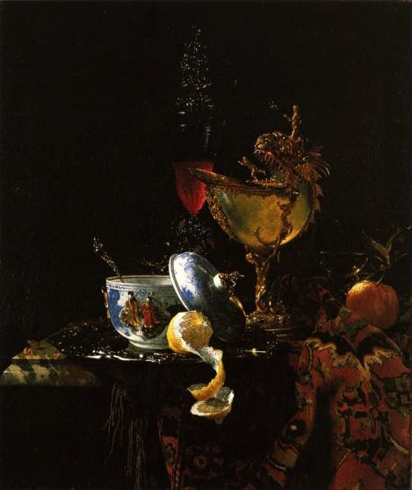
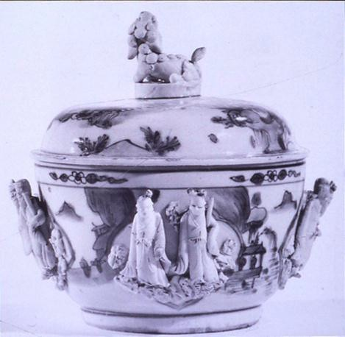
Willem Kalf, Still Life with Chinese Bowl, 1662

Slide 27
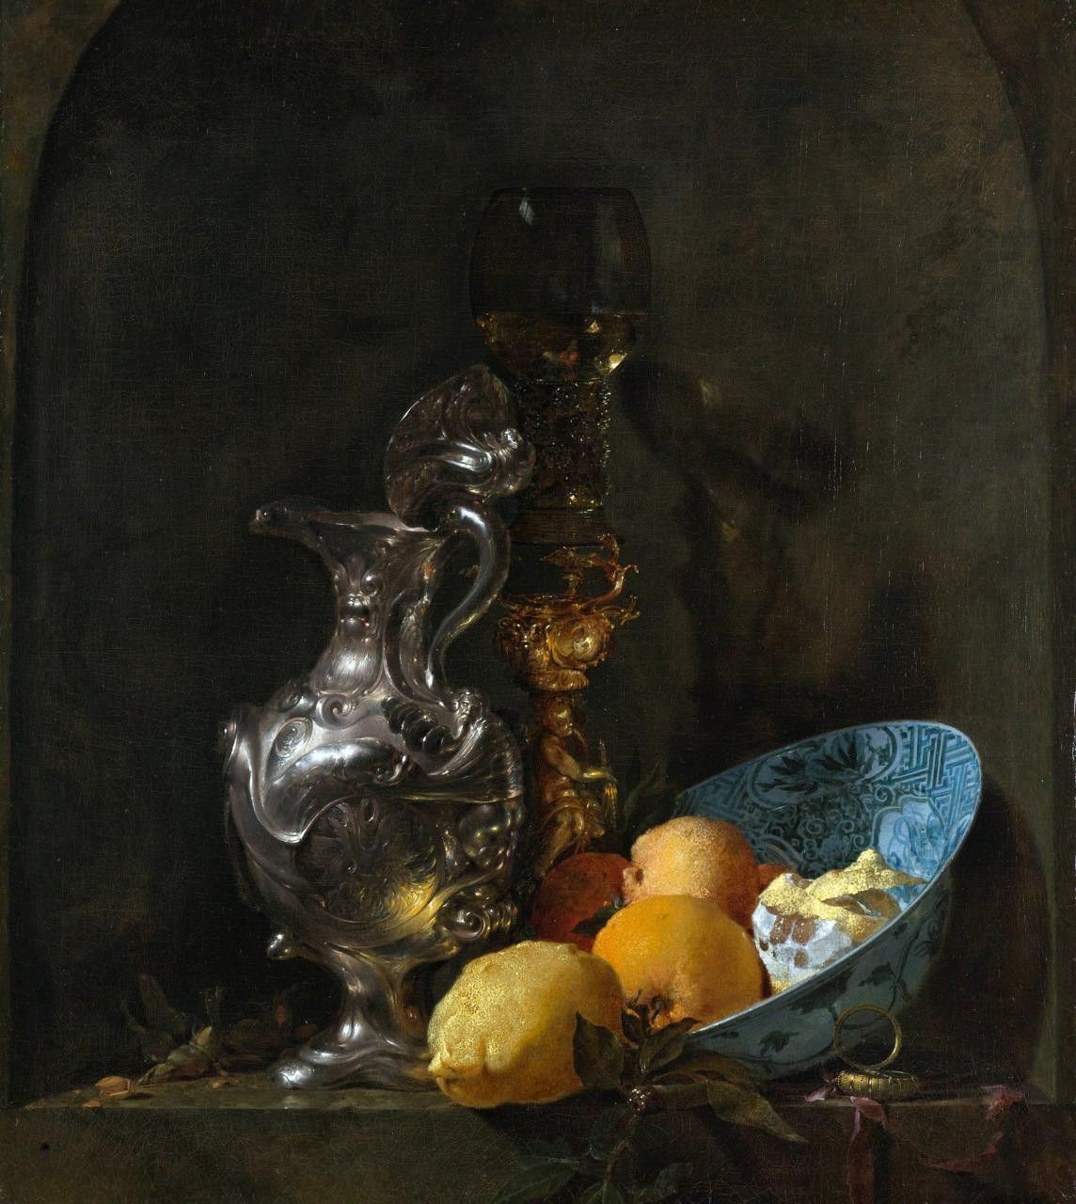
Willem Kalf, Still Life with Silver Ewer, Chinese Bowl and Lemons, 1655-7

Slide 28
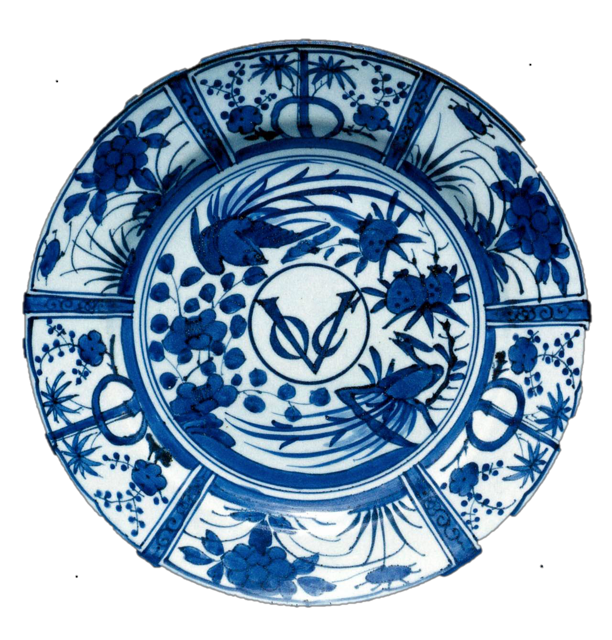
VOC (Dutch West Indies Company) plate, hard paste porcelain, Imari ware, Japan, export type, 15”, c.
1660

Slide 29
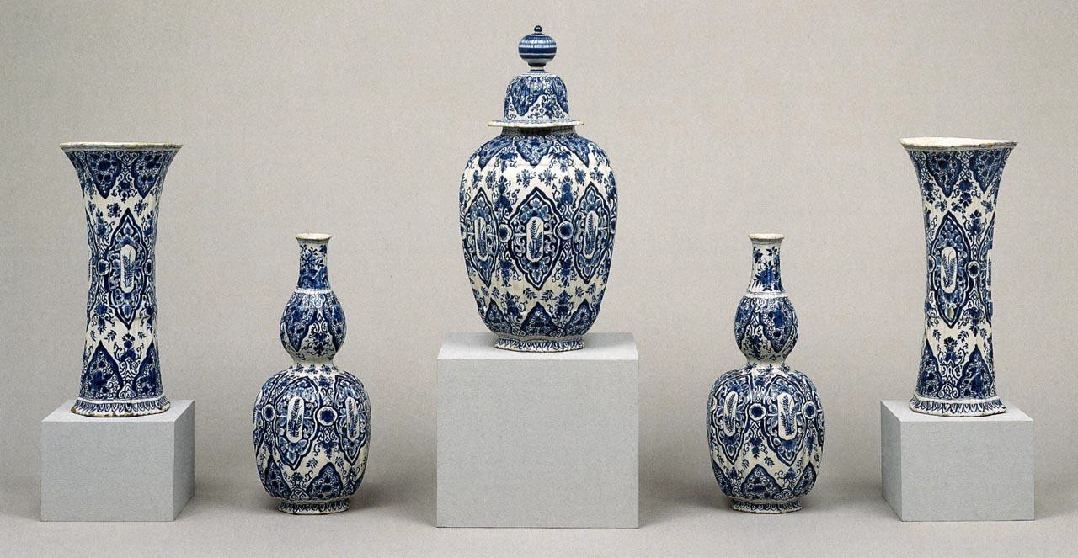
Garniture of five vases (kastel), Delftware, tin-glazed earthenware, 19”, signed by Lambertus van Eenhoorn, c. 1710

Slide 30
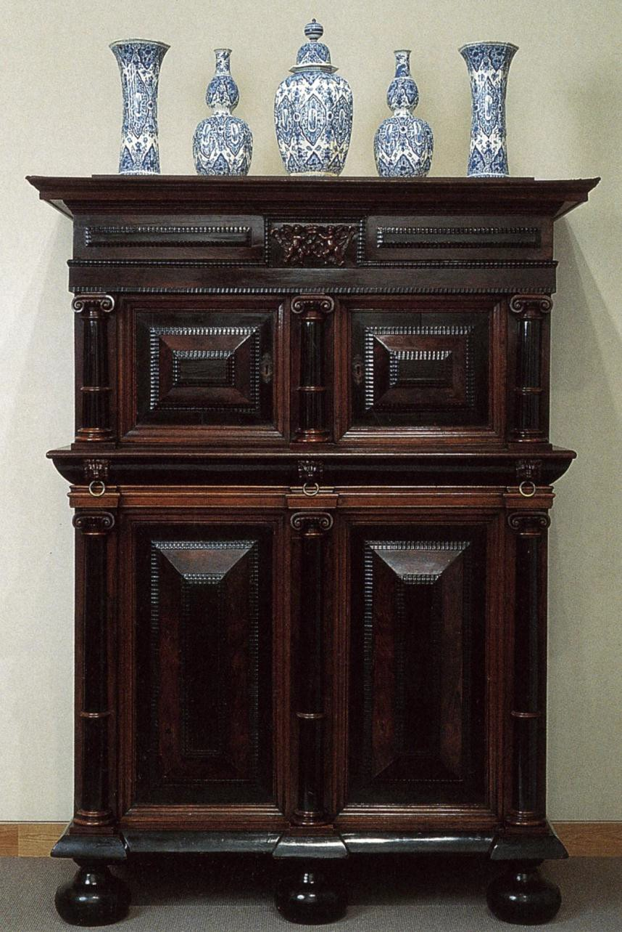

Slide 31
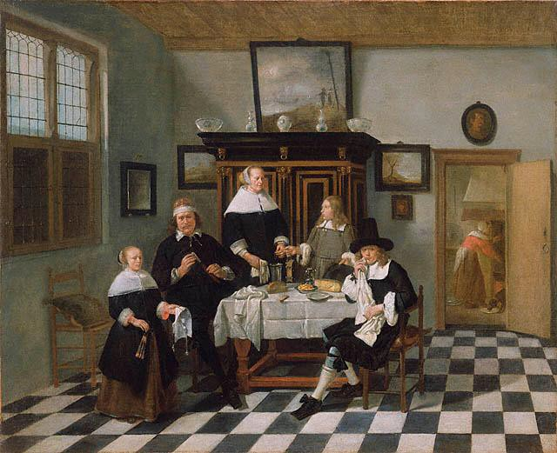
Cornelis de Man, Family at Dinner Table, o/c, 23 x 28”, c. 1665-70

Slide 32
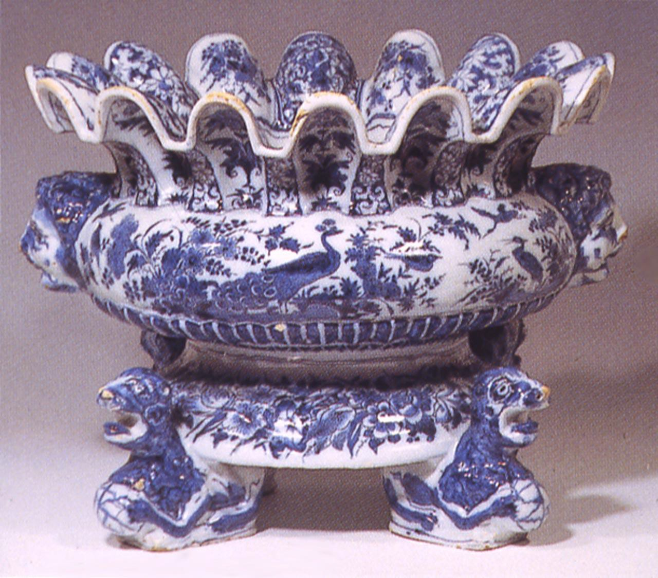
Delftware Wineglass Cooler, Netherlands, late 17th c.

Slide 33
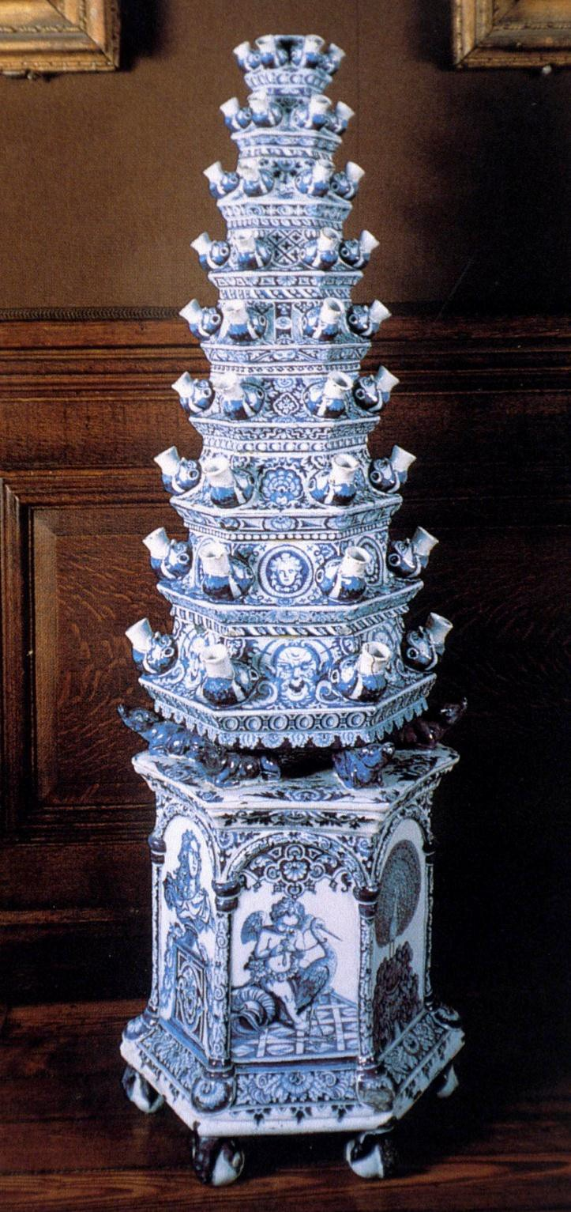
Delftware Tulip Vase, c. 48”, Netherlands, early 17th c.

Slide 34
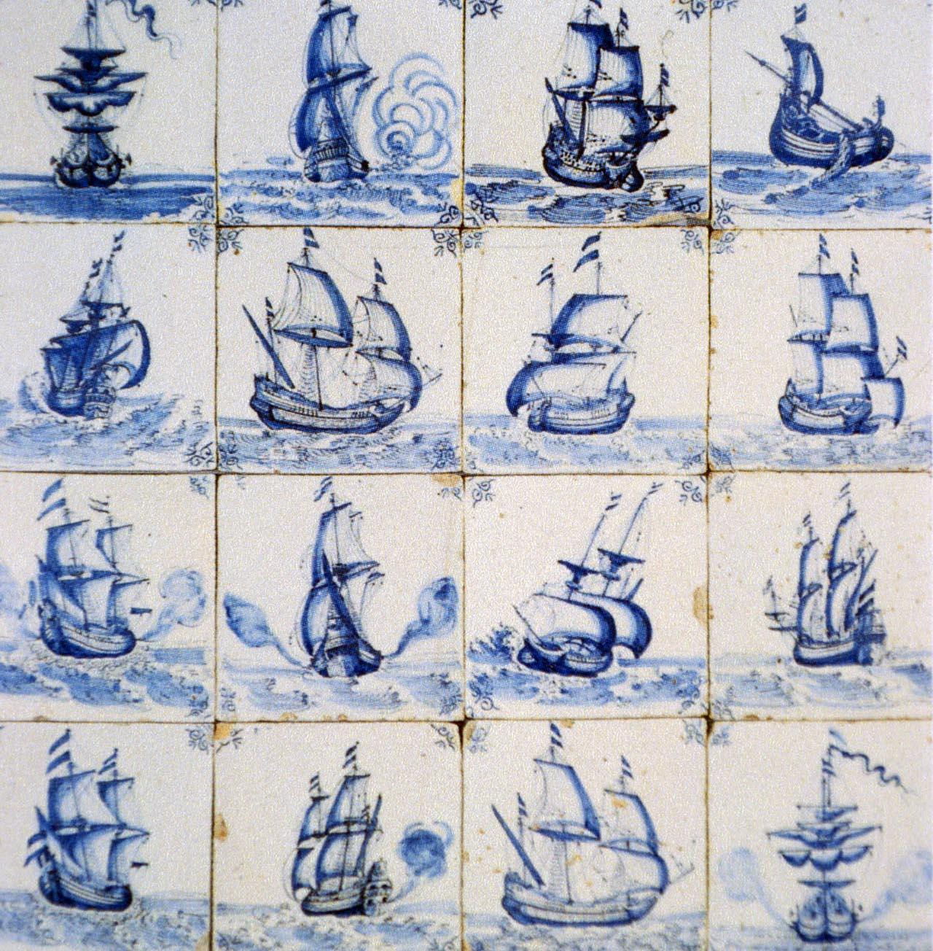
Delftware Tiles with Merchant Sailing Vessels, 16th c.

Slide 35
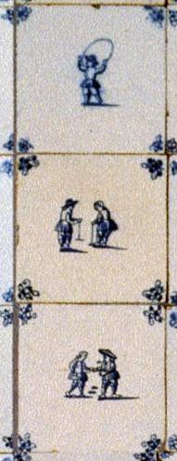
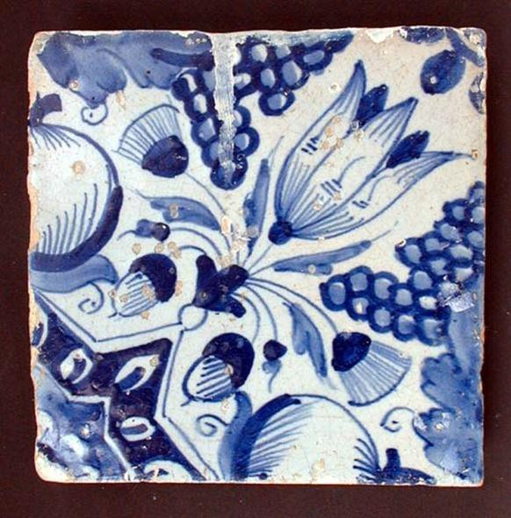
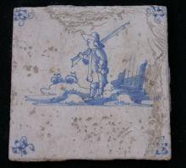

Delftware Tiles, various subjects, Netherlands, 17th c.

Slide 36


Left, Talavera Poblana Tiles, Puebla, Mexico, glazed terracotta, 5 x 5”, c. 1650

Slide 37

Talavera Poblana Earthenware Basin, glazed terracotta, 21”, Mexico, c. 1650

Slide 38

Pyramid Ceiling of De Santos Palace, Lisbon, 17th c.

Slide 39

Steeple encrusted with Chinese
porcelain dishes
Nossa Senhora de Coneicao do Monte, Cachoeira, Bahia, Brazil, 18th c.

Slide 40


Slide 42


Porcelain dish, China, 1590-1610
Talavera Poblama Earthenware Basin, Mexico, 26”, 18th c.

Slide 43

Plate, blue and white ware, Puebla, Mexico, c. 2011

Slide 44

Jingdezhen ware dish, cobalt blue underglaze, 18”, 14th c.
Plate, blue and white ware, Puebla, Mexico, c. 2011

Slide 45


Slide 46

Ceramics Shop, Mérida, Yucatán, Mexico, 2010

Slide 47


Medici factory
ewer, c. 1575-87
Mug sold in Metropolitan Museum of Art Shop to commemorate opening of new galleries of middle eastern art

Slide 48

•
ccr.1mK pnlL lKtlOll 111 t lL' •
IL L c • 1st. lC • llSClllll s co CCtlOll 10 s ,\ sp L'
H.:x.1go1u
ri le from lzn i k , m.1de .1bout 1535 . It" rcpc.lti ng flor.11 design contains sw1r1111g arahe-.que", m t ri1.:.ltc s.1 k.n es..rnd stylized tlo\\'crs encircling a central rosette. Our porccla111 mugs .u ·
b.1sed on the origi nal tile.
$40.0D

Slide 49
8 • 8 s 1 I\!l,l\J',' L
<
K L J 8 0 1097 7

Slide 53


