Slide 1
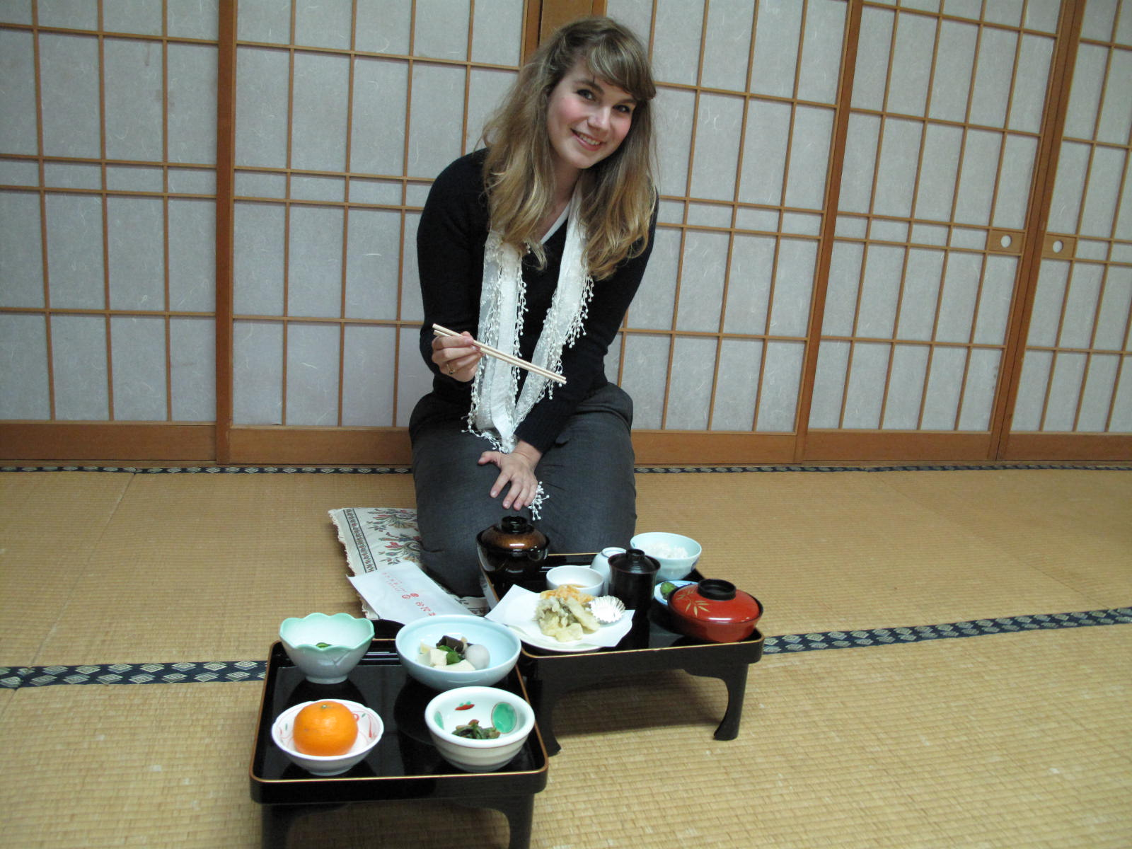
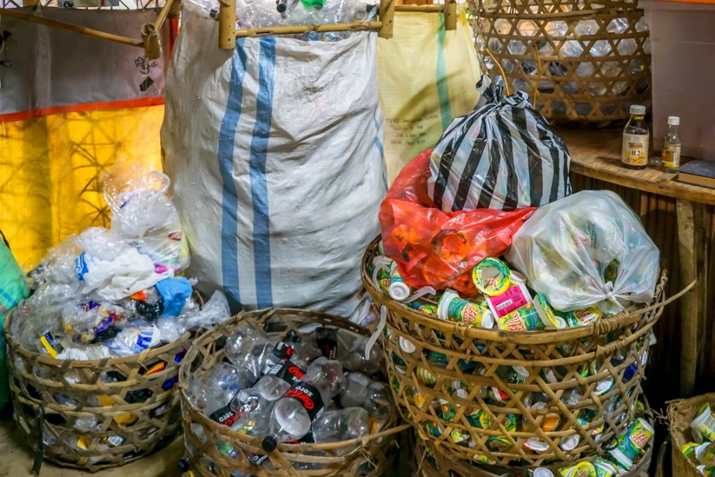
Recycle Blunder
English Teaching Assistant in Japan
Takes out the Trash

Slide 2
In the city where I live, we buy specific clear plastic trash bags. They have red, green, orange, blue or black writing on them. Each is for disposing of a different kind of material.

Slide 3
They won’t take it because there are food wrappers mixed in with the receipts and printer paper. Drat! The neighbors can see that I didn’t sort my paper right.
I put this paper for recycling and Oh NO! The collectors slapped the red sticker of shame on my bag!

Slide 4
Okay, no more mistakes. I heard there are two kinds of plastic bottles. How should I sort them?

Slide 5
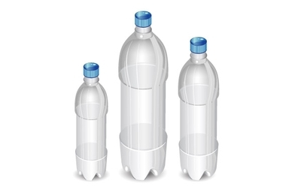
Are these PET bottles?

Slide 6
I sorted and rinsed bottles and cans. They took everyone’s but mine! The neighborhood trash patrol left me a warning note because the bottles had some water on the bottom. My trash has to be dried. I had to take the bottles and cans back inside my apartment. How often are these picked up?

Slide 7
We put out the paper to recycle, the burnable and unburnable trash today. I have a broken steam iron. How can I dispose of that?

Slide 8
Some kinds of cloth items are recycled and some go in burnable trash. What are the rules?

Slide 9
We bundle cardboard, but it’s only picked up twice a month. When is the next day to put it out?

Slide 10
It’s no good to just rinse and squash the milk cartons. What else do I have to do?

Slide 11
Wash it. Cut it. Let it dry. Then it is ready to bundle.

Slide 12
Can I bundle Pringles cans in with the milk cartons? My friend couldn’t figure it out, so he saved them up all year and left them in his hotel room the morning he flew back to the U.S!

Slide 13
What should I do with old batteries?

Slide 14
The streets are very clean, but public trash cans are rare in Japan. I have to think ahead about where to throw things away during the day.

Slide 15
Otherwise, they carry their trash home in their pockets. (It is rude to “graze” in Japan. People don’t walk and eat.)
People eat what they bought out in front of the convenience store so that they can throw the wrappers and containers away right there.

Slide 16
Convenience stores have trash and recycling bins! Can I just bring my trash there? I could just sneak in a little everyday…

Slide 17
Maybe a little pocket trash, but... My friend hung a plastic bag of burnable trash on his handlebars and stuffed it into the Family Mart rubbish bin when he stopped there for breakfast on the way to school.
Problem solved? Half way through his meal, the manager came charging up to him and gave him his trash back! Oh no!

Slide 18
Cute bananas! Wait, bananas already come naturally wrapped in a peel. This store is giving me a problem. Look near the produce section, and there may be a recycling bin to drop the plastic wrapper in before even leaving the store. Whew.

Slide 19
Thoughtfully disposing of the trash we make is a duty everyone does here. I’m getting used to thinking about what I use and discard.
Thank you for helping me figure all this out.
Sayonara!

