Slide 1
Three Takes on the Beginning: the historiography of early Japan
Charlotte Eubanks
JFNY K-12 Workshop
Penn State
May 2013

Slide 2
Objectives:
Explore the concept of historiography in an accessible and useful way.
Introduce materials that can be used to bring historiographical concepts into the classroom.
Examine source materials and supplementary materials closely.
Provide a bibliography for examining the topic more closely.
Create an experiential, hands-on learning situation.
Analyze the process of making history, with the question of Japan’s origins as a test case.
Encourage engaged curiosity among students with respect to primary texts and to the process of making history.

Slide 3
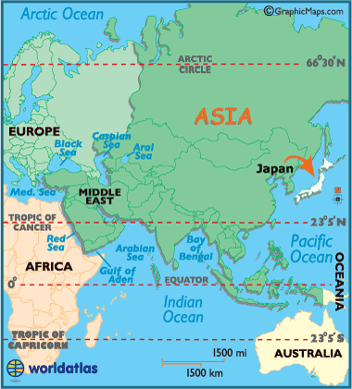
Defining ‘history’ worldatlas.com
A tale or story
A chronological record of significant events, often including an explanation of their causes
A treatise presenting systematically related natural phenomena
A branch of knowledge that records and explains past events

Slide 4
In other words…
Our ideas of history involve
A timeline
a sense of scientific objectivity
Facts
Cause and effect relationships
But also
The idea of a storyline
Attempts at explanation

Slide 5
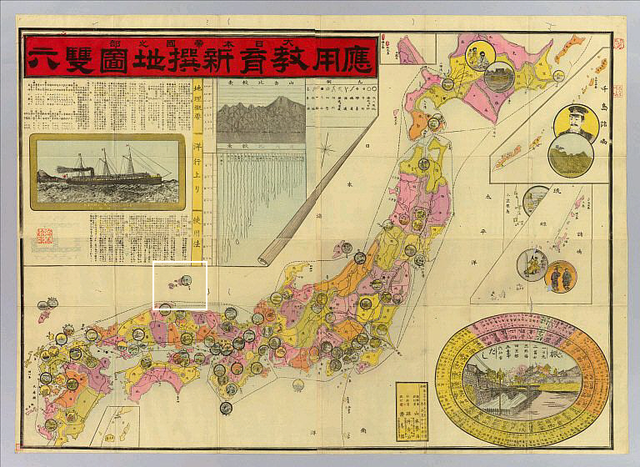
Defining ‘historiography’ [1569] dokdo-takeshima.org
The writing of history, especially as based on
The critical examination of sources
The selection of particulars from among authentic materials
The synthesis of particulars into a narrative that will stand the test of critical methods
The principles, theory, and history of historical writing
The product of historical writing: a body of historical literature

Slide 6
In other words… dokdo-takeshima.org
An awareness of history as a limited, chosen collection of authentic materials that have been examined, selected, and synthesized
A narrative that, however carefully constructed, is but one of many possible options
A narrative, therefore, of which we can be critical and which we can see as itself historically situated

Slide 7
Three Takes on the Beginning
1. Archaelogical Sources
2. Reports from Chinese Envoys
3. Mytho-History

Slide 8
Questions to keep in mind:
Who is making or recording the ‘history’?
How would you describe the voice of the recorders? Mystical? Informed? Decisive? Inquisitive? Authoritative? Annoyed? Reverent? Etc…
What is important for them to know and record? What do they spend the most space and time writing down? Do you find anything ‘missing,’ from your point of view?
What sorts of things do you see them paying special attention to? What do you see them glossing over or ignoring?
What sorts of biases and cultural assumptions might these concentrations of interest reveal?
How might these assumptions and biases be affecting the recording and interpretation of ‘history’?

Slide 9
Take 1: the archaeological record
Excerpts from Richard K. Beardsley, “Japan before History: A Survey of the Archaeological Record.” Far Eastern Quarterly (May 1955): 317-46.

Slide 10
“ In the late 19th and early 20th centuries two Americans, ES Morse and NG Munro, did much to open Japanese eyes to dirt archeology as one of the historical tools for elucidating Japan’s past. Thereafter Japanese researchers published some English or German summaries on Japan’s ancient remains and for a few decades Westerners wrote with much interest of new discoveries concerning Jōmon, Yayoi and occasionally Tomb cultures. But Western interest was short-lived and Japanese archeology went out of fashion in Western journals…. Japanese research went ahead, however, and has given rise to radical interpretations which have not found their way into Western language literature. My purpose here is to present briefly a review of the period prior to the first flourishing of Buddhism in Japan and to offer some suggestions toward fitting these findings into the larger picture of Asiatic cultural development….

Slide 11
[T]he question of racial and cultural identification is not simple. In Japan it was necessary, first to realize that race-language-culture, the triad by which a people is identified, is not a single, indivisible unit that persists or changes as a whole. Cultural diffusion, for example, may displace certain elements or the entirety of a cultural tradition without any accompanying shift of population or language…. Racial identification, as such, has become the special concern for physical anthropologists, who have found that the Jōmon populations were quite variable….
[N]ew questions of considerably wider significance to culture history and culture theory have now been asked, and require much broader views for their answers. How unified was the culture of Japan at any particular point? How were the transitions accomplished from one culture type to the next? How closely was Japan tied to the continent, and to what part of the continent, at different prehistoric times? What of prehistoric relations to the center of civilization in China? By what steps did economic and social development occur? How do all of these match with the march of civilization in other parts of the world? …

Slide 12
[R]emains of the Jōmon peoples have been found in almost 1000 shell mounts as well as other sites scattered, without notable exception, in every region of Japan. Their culture was not at the level of those of the Neolithic period in culture centers of the world except that they had pottery-making and the art of shaping stone tools by grinding and polishing instead of merely chipping. The Jōmon peoples had no cultivated crops and no domestic animals except the dog, no loom-weaving of textiles and only the simplest of carpentry, so that sub-Neolithic or some such qualifying term should be used to categorize their cultural level. Though their culture became impressively elaborated in the course of centuries of development, the lack of techniques for stable food production set a subsistence ceiling much below that of the culture centers of Eurasia, where crops and domestic animals laid the foundation for population growth, the multiplication of specialized crafts, and the emergence of other elements of advanced civilization.

Slide 13
However rich the local food resources, the Jōmon people had to spend a large portion of their time merely gathering food. They lived in the foothills where deer and acorns could be found or settled at somewhat more permanent locations near the seashore for fishing and shellfish gathering. After a time, a litter of animal bones and waste or piles of shell refuse accumulated as an indelible telltale of their favored camp-sites. Though the same group might return seasonally to a previous settlement, they probably were able to live more than a few weeks at only certain localities before having to move on to fresh hunting and gathering grounds…
Dwellings… varied in shape from region to region…. There emerges from the variety a general pattern: a simple, one-room dwelling, usually subterranean, with four main pole supports around a central fireplace….
Very near the houses and within the settlement area were the graves of the dead, who were buried simply in individual pits, limbs flexed. By placing the graves near the home to protect the body from molestation, the survivors seem to have shown some concern for the dead, but they rarely put offerings other than ocher with the corpse and set up no permanent markers.”

Slide 14
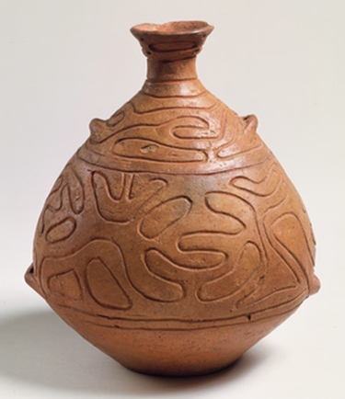
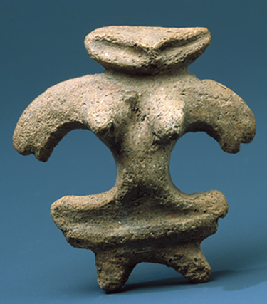
Jōmon Period
11,000 BCE – 300 BCE
“Rope mark” pottery
Hunter-fisher-forager culture
Partially nomadic
Lots of body art and tattoos
Tombs, especially those in Yamato Plain area, almost always facing east
http://ls.berkeley.edu/dept/anth/habufieldschool/Overview%20pics/Goals%202007.jpg
www.metmuseum.org

Slide 15
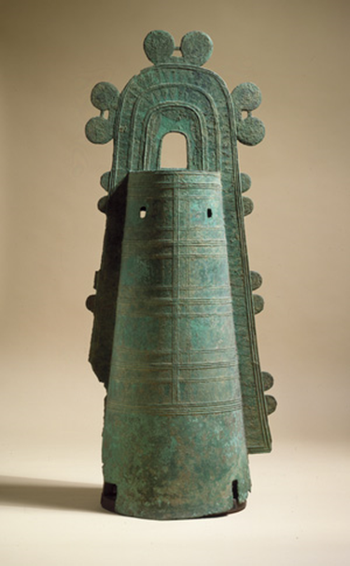
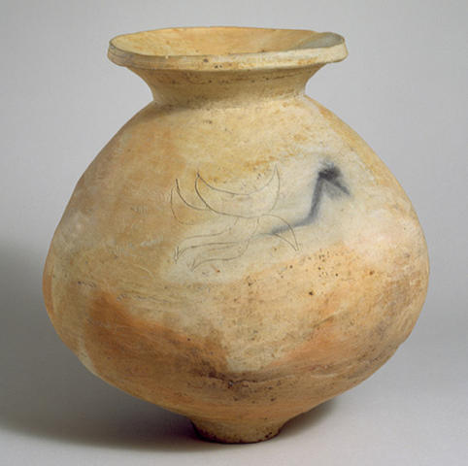
Yayoi Period
300 BCE – 300 CE
3 major advances:
Smoother, more evenly fired pottery with greater artistic variation
Metal working of bronze, especially of bells
Wet rice agriculture
http://www.interculturaljapan.com/wordpress/wp-includes/images/pics/toro.jpg
www.metmuseum.org

Slide 16
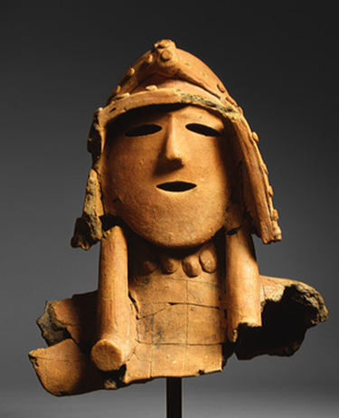
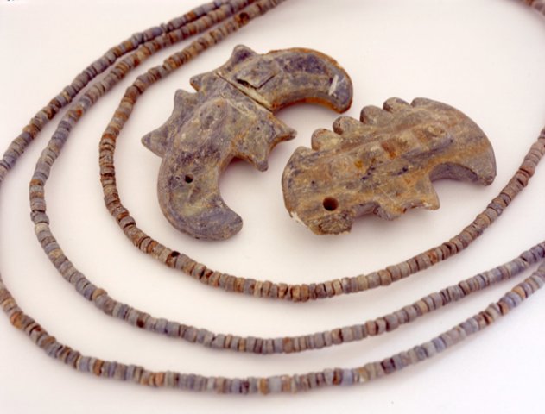
Kofun (Tomb) Period
300 CE – 550 CE
3 major advances:
Pottery wheel imported from Korean peninsula cultures
Enormous tombs (kofun 古墳) with figurines (haniwa 埴輪), body typically seated and facing east
Sustained contact with continental culture, especially China, via envoys
http://www.crystalinks.com/japantomb.jpg
www.metmuseum.org
http://suisin.jimu.kyushu-u.ac.jp

Slide 17
What did you notice?
Who is making or recording the ‘history’?
How would you describe the voice of the recorders? Mystical? Informed? Decisive? Inquisitive? Authoritative? Annoyed? Reverent? Etc…
What is important for them to know and record? What do they spend the most space and time writing down? Do you find anything ‘missing,’ from your point of view?
What sorts of things do you see them paying special attention to? What do you see them glossing over or ignoring?
What sorts of biases and cultural assumptions might these concentrations of interest reveal?
How might these assumptions and biases be affecting the recording and interpretation of ‘history’?

Slide 18
Take 2: Chinese Envoys’ Records
Excerpts from “History of the Kingdom of Wei” (ca. 297), from Wm. Theodore deBary, ed. Sources of Japanese Tradition. New York: Columbia University Press, 1958. Pp 3-12.

Slide 19
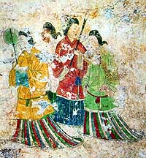
The first appearance of Japan in Chinese records is ca. 57 ce
On the Japanese archipelago we have:
On the Chinese continent, we have:
We’re in the middle of the Yayoi period so….
A written language
A tradition of recorded history and philosophy
An established system of state (expansion/tribute)
A sense of itself as a cohesive culture
Technology and diplomatic skills enough to maintain extensive cultural contact throughout Asia
www.japantimes.co.jp/images/photos2005/nn20050418a3a.jpg

Slide 20
“The people of Wa dwell in the middle of the ocean on the mountainous islands southeast of Tai-fang. They formerly comprised more than 100 communities. During [an earlier] dynasty, [Wa] envoys appeared at the court; today, 30 of their communities maintain intercourse with us through envoys and scribes….
The land of Wa is warm and mild. In winter as in summer the people live on raw vegetables and go about barefooted. They have houses; father and mother, elder and younger, sleep separately. They smear their bodies with pink and scarlet, just as [we] use powder. They serve food on bamboo and wooden trays, helping themselves with their fingers. When a person dies, they prepare a single coffin, without an outer one. They cover the graves with earth to make a mound. When death occurs, mourning is observed for more than 10 days, during which period they eat no meat. The head mourners wail and lament, while friends sing, dance, and drink liquor. When the funeral is over, all members of the family go into the water to cleanse themselves in a bath of purification.

Slide 21
When they go on voyages across the sea to visit China, they always select a man who does not comb his hair, does not rid himself of fleas, lets his clothing get as dirty as it will, does not eat meat, and does not lie with women. This man behaves like a mourner and is known as the ‘mourning keeper.’ When the voyage meets with good fortune, they all lavish on him slaves and other valuables. In case there is disease or some mishap, they kill him, saying that he was not scrupulous in keeping the taboos….
Whenever they undertake an enterprise or a journey and a discussion arises, they bake bones and divine in order to tell whether fortune will be good or bad. First they announce the object of divination, using the same manner of speech as in [our practice of ] tortoise shell divination; they then examine the cracks made by the fire to tell what is to come to pass.
In their meetings and in their deportment, there is no distinction between father and son or between men and women. They are fond of liquor. In their worship, men of importance simply clap their hands instead of kneeling or bowing. The people live long, some to 100 and others enjoy 80 or 90 years. Ordinarily, men of importance have 4 or 5 wives; the lesser ones, 2 or 3. Women are not loose in morals or jealous.

Slide 22
In the case of violation of the law, the light offender loses his wife and children by confiscation; as for the grave offender, the members of his household and also his kinsmen are exterminated. There are class distinctions among the people and some men are vassals of others. Taxes are collected. There are granaries as well as markets in each province, where necessaries are exchanged under the supervision of Wa officials….
The country formerly had a man as ruler. For some 70 or 80 years after that there were disturbances and warfare. Thereupon the people agreed upon a woman for their ruler. Her name was Pimiko. She occupied herself with magic and sorcery, bewitching the people. Though mature in age, she remained unmarried. She had a younger brother who assisted her in ruling the country. After she became the ruler, there were few who saw her. She had 1000 women as attendants, but only 1 man. He served her food and drink and acted as a medium of communication. She resided in a palace surrounded by towers and stockades, with armed guards in a state of constant vigilance….

Slide 23
In the 6th month of the second year of Ching-ch’u [238] the Queen of Wa sent the grandee Nashinomi and others to visit [the coast of our country] where they requested permission to proceed to the Emperor’s court with tribute….
When Pimiko passed away, a great mound was raised, more than 100 paces in diameter. Over 100 male and female attendants followed her to the grave. Then a king was placed on the throne, but the people would not obey him. Assassination and murder followed; more than 1000 were thus slain.
A relative of Pimiko named Iyo, a girl of 13, was [then] made queen and order was restored. Cheng [the Chinese ambassador] issued a proclamation to the effect that Iyo was the ruler. Then Iyo sent a delegation of 20 under the grandee Yazaku, General of the Imperial Guard, to accompany Cheng home [to China]. The delegation visited the capital and presented 30 male and female slaves. It also offered to the court 5000 white gems and 2 pieces of carved jade, as well as 20 pieces of brocade with variegated designs.”

Slide 24
What did you notice?
Who is making or recording the ‘history’?
How would you describe the voice of the recorders? Mystical? Informed? Decisive? Inquisitive? Authoritative? Annoyed? Reverent? Etc…
What is important for them to know and record? What do they spend the most space and time writing down? Do you find anything ‘missing,’ from your point of view?
What sorts of things do you see them paying special attention to? What do you see them glossing over or ignoring?
What sorts of biases and cultural assumptions might these concentrations of interest reveal?
How might these assumptions and biases be affecting the recording and interpretation of ‘history’?

Slide 25
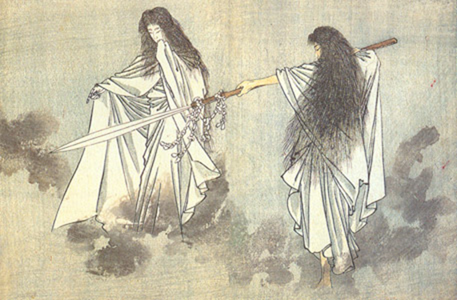
Take 3: Mytho-history
Excerpts from the Kojiki [A record of ancient matters], trans. Donald Phillipi. Princeton: Princeton University Press, 1969.
webmitologia.com/images/mitologia-japonesa-izanagi-izanami.jpg

Slide 26
On the 18th day of the 9th month of the 4th year of Wado [711] , an imperial command was given to me, Yasumaro, to record and present the Kuji [‘Ancient Dicta’, an oral mytho-history in verse form, which was memorized by special functionaries of the court appointed for the task] learned by imperial command by Piyeda no Are. Reverently, in accordance with the imperial will, I chose and took them up in great detail. However, during the times of antiquity, both words and meanings were unsophisticated, and it was difficult to reduce the sentences and phrases to meaning….
In general, the account begins with the beginning of heaven and earth and end with the reign of Woparida [Empress Suiko]…. Thus do I, Yasumaro, full of awe, full of fear, reverently bow my head again and again [as I submit the record of these oral histories, which now begin]….
At this time [after 7 generations of the age of the gods], the heavenly deities, all with one command, said to the 2 deities Izanagai and Izanami, “Complete and solidify this drifting land!” Giving them the Heavenly Jeweled Spear, they entrusted the mission to them. Thereupon the 2 deities stood on the Heavenly Floating Bridge and, lowering the jeweled spear, stirred with it. They stirred the brine with a churning-churning sound, and when the lifted [the spear] up again, the brine dripping down from the tip of the spear piled up and became an island…. [and thus they make the islands of the Japanese archipelago].

Slide 27
At this time [after the birth of many children between the pair], Izanagi, rejoicing greatly, said, “I have borne child after child, and finally in the last bearing I have obtained 3 noble children.” Then, he removed his necklace, shaking the beads on the string so that they jingled, and, giving it to Amaterasu, he entrusted her with a mission, saying, “You shall rule [the land during the daylight hours].” Next he said to Tsukuyomi, entrusting him with his mission, saying, “You shall rule the realms of night.” Next, he said to Susano-o, entrusting him with his mission, “You shall rule the ocean.”
While [the other deities] ruled in obedience to the commands entrusted to them, Susano-o… instead wept and howled [and eventually does a bunch of nasty things like defecating in Amaterasu’s weaving room, busting apart her rice paddies, and flaying a horse and throwing it at her].
At this time, Amaterasu, seeing this, was afraid, and opening the heavenly rock-cave door, went in and shut herself inside. Then the land was completely dark, and the Central Land of the Reed Plains became completely dark.
[The deities gather a number of appealing things to try to lure her out. Two of these – a mirror and a string of jewels – go on to become 2 of the 3 imperial regalia of Japan.]

Slide 28
Tadikara stood concealed beside the door [to the cave], while Uzume bound up her sleeves with a cord of heavenly Pikage vine, tied around her head a head-band of heavenly Masaki bind, bound together bundles of Sasa leaves to hold in her hands, and overturning a bucket before the heavenly rock-cave door, stamped resoundingly on it. Then she became divinely possessed, exposed her breasts, and pushed down her skirt-band to her genitals.
Then… all the 800 myriad deities all laughed at once. Then Amaterasu, thinking this strange, opened a crack in the rock-cave door and said from within, “Because I have shut myself in, I thought the land would be dark…. But why is it that Uzume sings and dances, and all the 800 deities laugh?” Then Uzume said, “We rejoice and dance because there is a deity here superior to you.”
While she was saying this, [the other deities] brought out the mirror and showed it to Amaterasu. Then Amaterasu… gradually came out the door… and Tadikara took her hand and pulled her out. Immediately Putotama extended a Siri-kume rope behind her and said, “You may go back no further than this!”
[And so Amaterasu comes out and Susano-o is punished. He slays a dragon, finds a sword in its tail, and presents the sword as the 3rd imperial regalia. The descent of Amaterasu’s offspring is then recounted, ending with the historical Empress Suiko.]

Slide 29
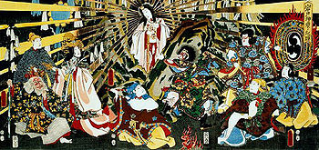
What did you notice?
Who is making or recording the ‘history’?
How would you describe the voice of the recorders? Mystical? Informed? Decisive? Inquisitive? Authoritative? Annoyed? Reverent? Etc…
What is important for them to know and record? What do they spend the most space and time writing down? Do you find anything ‘missing,’ from your point of view?
What sorts of things do you see them paying special attention to? What do you see them glossing over or ignoring?
What sorts of biases and cultural assumptions might these concentrations of interest reveal?
How might these assumptions and biases be affecting the recording and interpretation of ‘history’?

Slide 30
A historiographical approach helps students…
Treat history more inquisitively
Treat primary documents with a more critical and informed eye
Think more clearly about the who-what-why-where-when-how of history making
Draw meaningful connections between different historical events and phenomena, and the different accounts of those events
Engage with history as a creative process

Slide 31
Some possible ways to extend this lesson…
Introducing contradictory accounts of more recent events
Introducing an historical account and then asking students to research how that account was made
Reviewing old magazines and newspapers, to contrast older studies with more current ideas
Examining how an historical account takes root in popular culture and examining the differences (both in presentation and in the choice of historical detail) between artistic and scholarly versions
Examining and discussing primary documents before introducing a standard textbook account of what those documents ‘say’

Slide 32
Further resources
For the most recent academic thinking on Japanese origins:
Amino, Yoshihiko. Rethinking Japanese History. Ann Arbor, MI: Center for Japanese Studies, 2012.
Soumaré, Massimo. Japan in Five Ancient Chinese Chronicles: Wo, the Land of Yamatai, and Queen Himiko. Tokyo: Kurodahan Press, 2009.
For different versions of the Kojiki events:
Aston, WG, transl. Nihongi: Chronicles of Japan from the Earliest Times to AD 697. London: Kegan Paul, Trench, Trunber and Co, 1896.
Yamaguchi Aoki, Michiko, trans. Izumo Fudoki. Tokyo: Sophia University, 1971.
For a more contemporary archaeological account:
“Emergence of neo-Asianism reflects Japan’s identity search.” Nikkei Weekly, vol. 32, no. 1603 (Jan 17, 1994), p 1, cont’d on p. 22.
“Ethnologists review Japan’s origins.” Nikkei Weekly, vol. 32, no. 1603 (Jan 17, 1994), p 20.
For further pedagogical ideas:
Conrad, Sebastian. “What Time is Japan? Problems of Comparative (Intercultural) Historiography.” History and Theory 38:1 (1999): 67-83.
Green, Robert P., Jr. “Reconstruction Historiography: A Source of Teaching Ideas.” The Social Studies (July/August 1991): 153-7.

