Slide 1

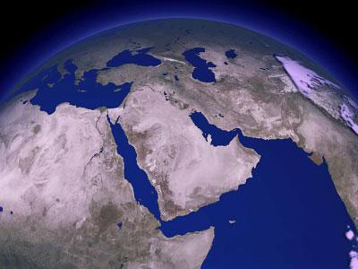
Contesting Paradigms and Redefining Perceptions of the Middle East
By: Walter Lorenz
Lecturer in Arabic
Pennsylvania State University

Slide 2
Purpose of Presentation
This presentation will discuss the various communities of the Middle East. The goal is to redefine terms that have marked the region as “The Arab World,” and “The Muslim World” that is quite often used in political statements and the media.

Slide 3
Topics to be Discussed
What is “Middle Eastern” and “The Middle East”
Discussing Communities: Religions and Languages
“The Arab World” and “The Muslim World”
Summary
Conclusion

Slide 4

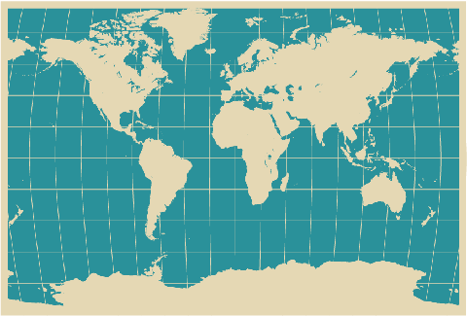
Question:
What is “Middle Eastern?”
How do we define the Middle East?

Slide 5
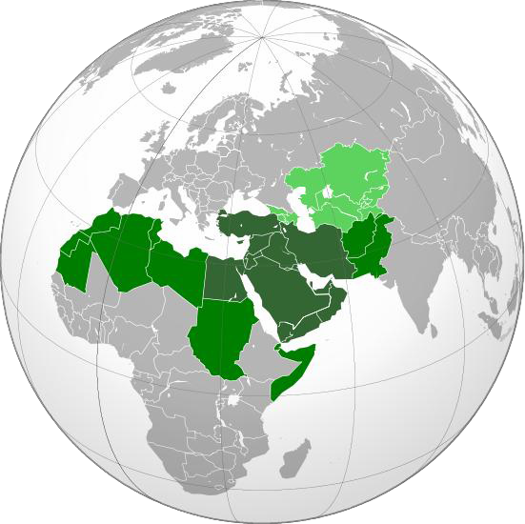
Traditional Definition of the Middle East
Before WWI
  "Near East" = Balkans and the Ottoman Empire
  "Middle East" =Iran, Afghanistan, and Central Asia.
In 1957, the U.S. officially uses Middle East for the region around the Suez Canal.

Slide 6
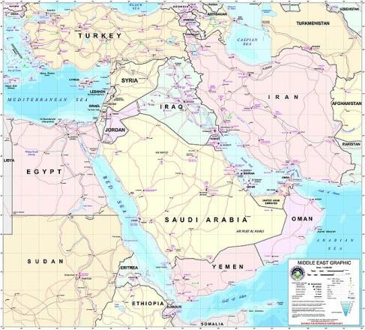
Controversial Boundaries

Slide 7
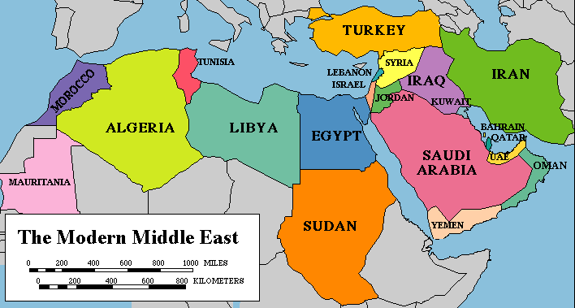
Controversial Boundaries

Slide 8
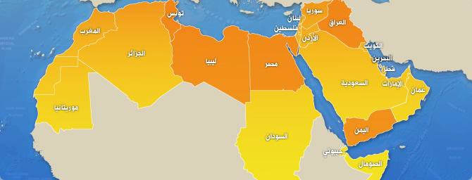
Controversial Boundaries

Slide 9
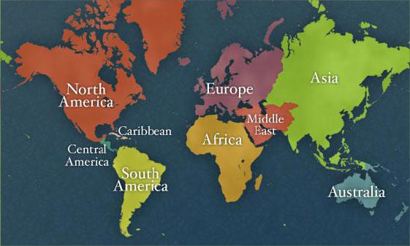
Controversial Boundaries

Slide 10



Diverse Communities: Languages and Religions
What are the languages and the communities that exist in the region?

Slide 11
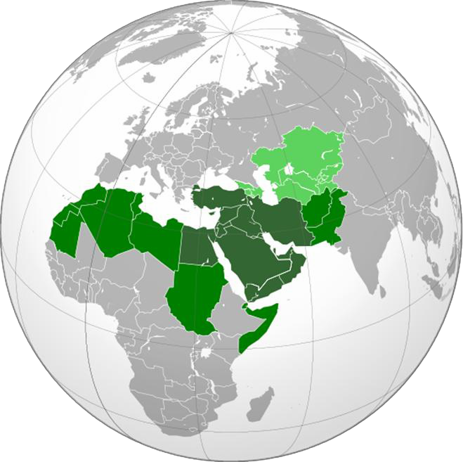
List of Languages
(Dark Green)
Arabic, Aramaic, Azerbaijani, French, Greek, Hebrew,
Kurdish, Persian, Turkish.
(Light and Dark Green)
Arabic, Armenian, Azerbaijani, Balochi, Dari, French, Greek, Georgian, Hebrew, Kurdish, Pashto, Persian, Punjabi, Sindhi, Somali, Tamazigh, Tigrinya, Turkish.

Slide 12
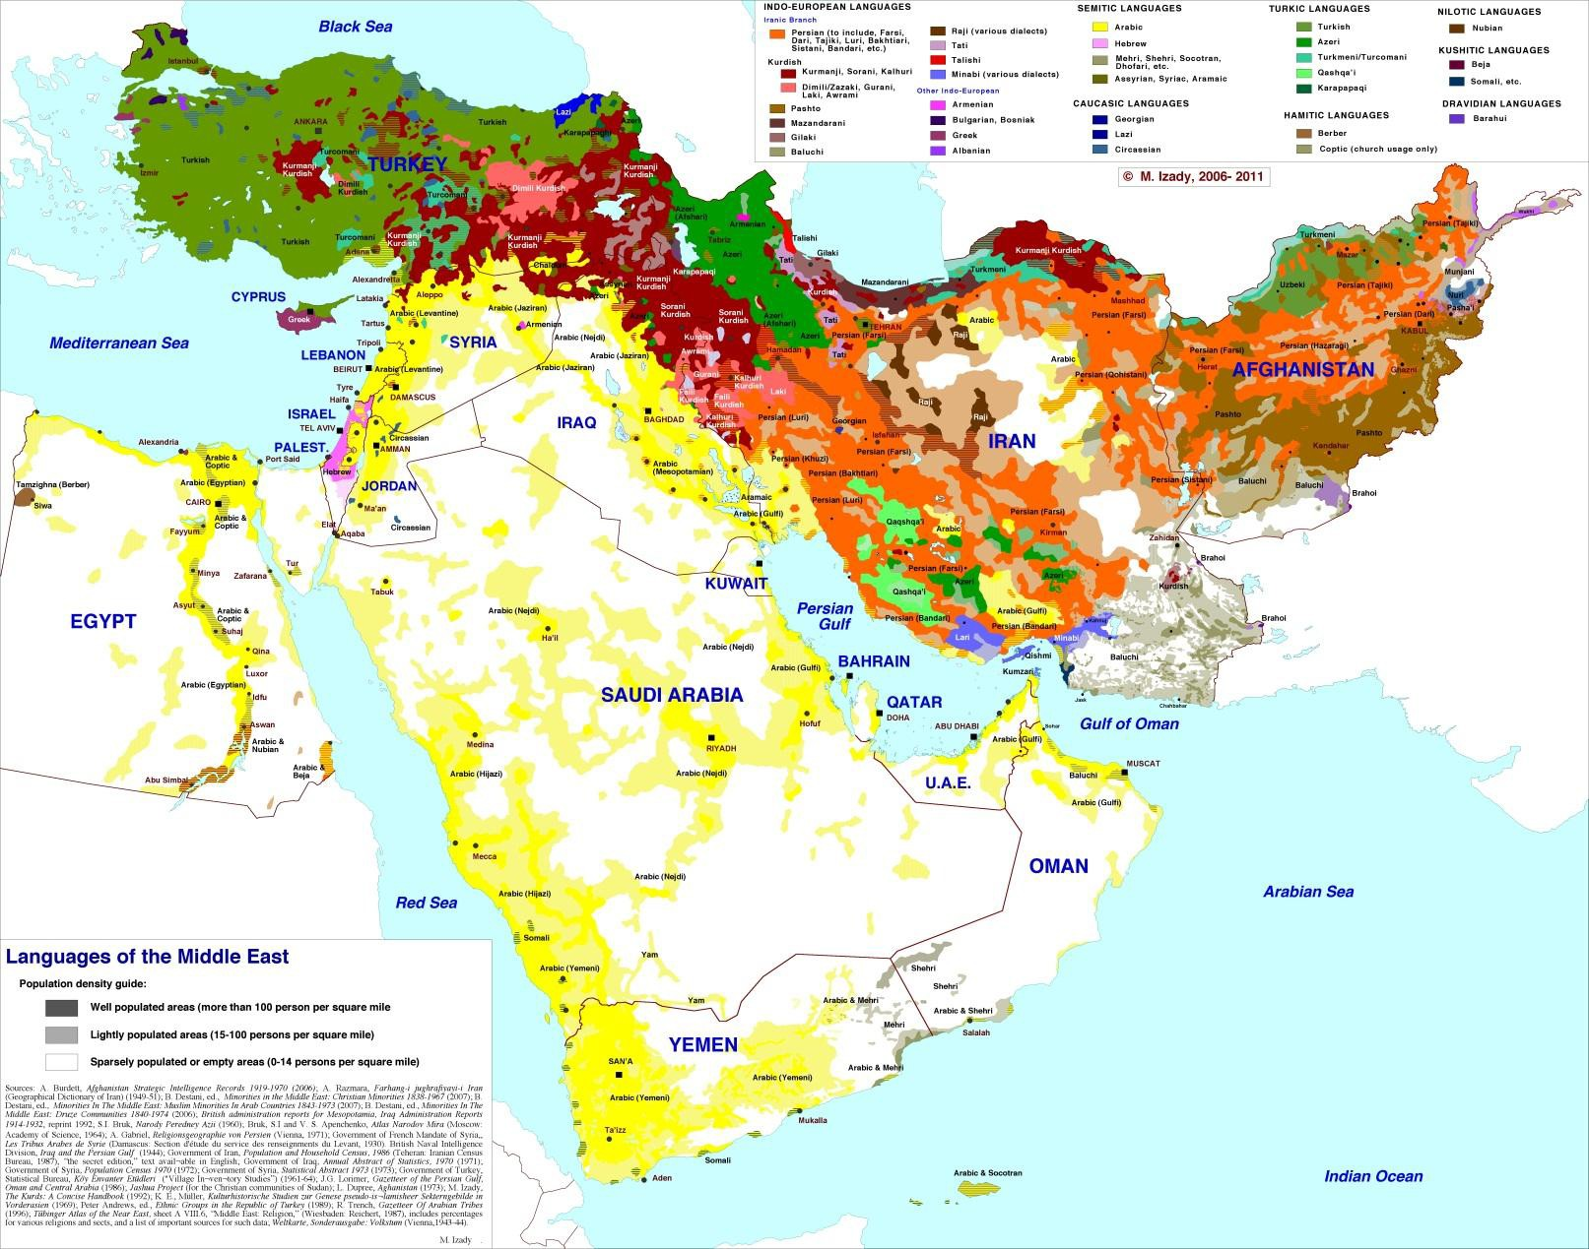
Map of Languages Spoken

Slide 13
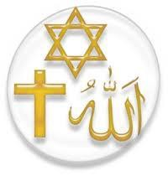
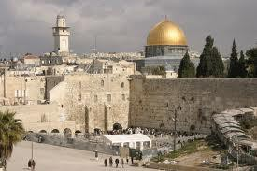
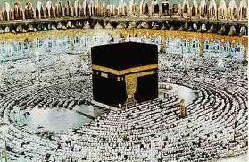
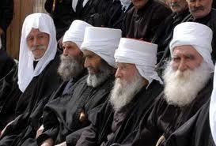
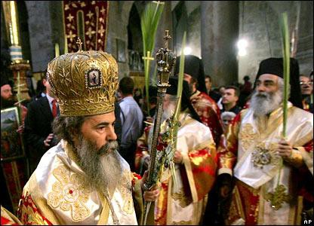
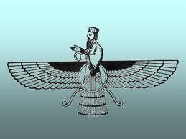
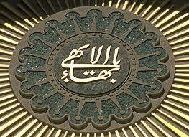
Major Religious Communities
Islam (Sunni and Shiite sects)
Christianity (numerous sects such as Nestorian, Greek Orthodox, Maronite, Armenian, Coptic, etc).
Judaism
Zoroastrianism
Druze
Bahá'í

Slide 14
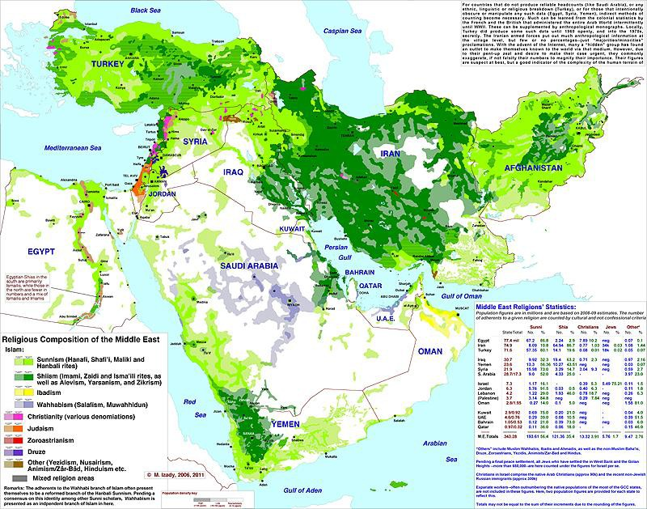
Religious Communities

Slide 15
Terminology and the Media
Two Commonly Used Terms in the Media.
“The Arab World” and “The Muslim World”
Question:
What are some images that come to mind when you hear
these terms?

Slide 16
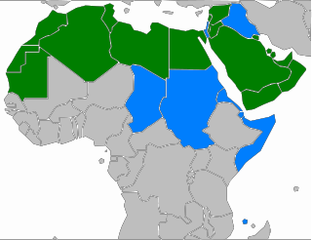
Arabic Speaking Countries
Arab League: “An Arab is a person whose language is Arabic, who lives in an Arabic-speaking country, and who is in sympathy with the aspirations of the Arabic-speaking peoples.”
Many peoples of non-Arab origins, such as Egyptians and Phoenicians, may or may not identify themselves as Arabs.
Arabic dialects differ regionally.

Slide 17
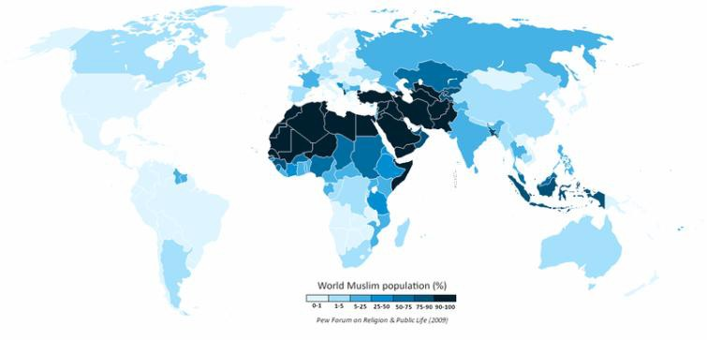

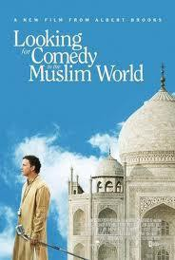
What is “The Muslim World?”
Overall, Arabs make up less than one quarter of the world's 1.4
billion Muslims.
How can we define “The Muslim World?” Does this “world” have borders and how many worlds are there?

Slide 18
Summary
The region defined as the Middle East is a controversial boundary that is difficult to define both culturally and physically.
Multiple religious and linguistic communities that are usually overshadowed by an “Arab or Muslim Middle East.”
“The Muslim World” or “The Arab World” are problematic in that they marginalize the diversity of the region.
The media propagates the popular portrayal of these
ideas. Can we redefine them?

Slide 19
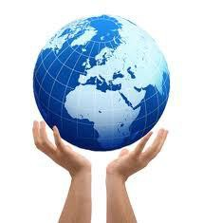
Thank you!

